Slide 1
Transformations for Obfuscating Object-Oriented Programs
Name: Hao Yuan
Supervisor: Len Hamey

Slide 2
Agenda
Introduction
Transformations
Conclusion

Slide 3
Problem
Programmers
Protected
Secured
Reverse engineers
Decompile the code
Opposite goals

Slide 4
Aim
Describe ways to transform the object-oriented programs
Hard to understanding (confuse human reader)
Difficult to reverse engineer (confuse machine)
Obfuscation examples
if (true){ if (!true){
execute;} exit;}
else{exit;} else{execute;}
int A=3;
int a1=1;
int a2=2;

Slide 5
Significance
Source codes are easily stolen and modified
Nolan’s Decompiling Java
Reuse, misuse, attack
Protect source code and prevent automated reverse engineering
Watermarking, obfuscation, tamper-resistance
Obfuscation is the most effective method
protect software against malicious reverse engineering
make the code more complex and confusing

Slide 6
What Has Been Achieved
Obfuscating tools
Allatori
Dash-O-Pro
Proguard
RetroGuard
yGuard (Free)
Zelix Klassmanster
No guarantee
Perfect obfuscator

Slide 7
Evaluation of Obfuscation
Strength can be measured by:
Potency
E(P’)/E(P)-1
Confuse human reader
Resilience
Trivial, weak, strong, full, one-way
Confuse automated reverse engineering
Cost
Free, cheap, costly, expensive
Creation, execute time

Slide 8
Agenda
Introduction
Transformations
Conclusion

Slide 9
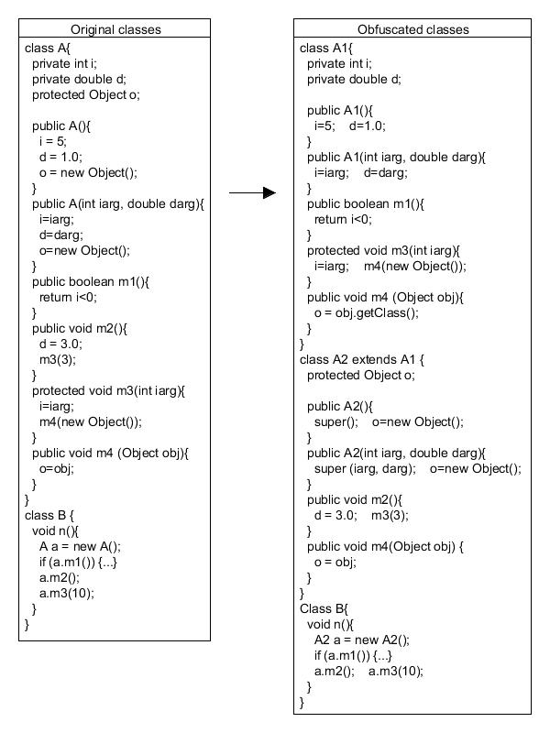
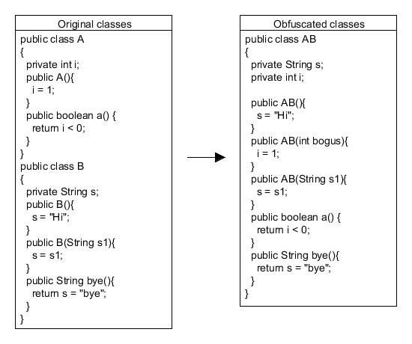
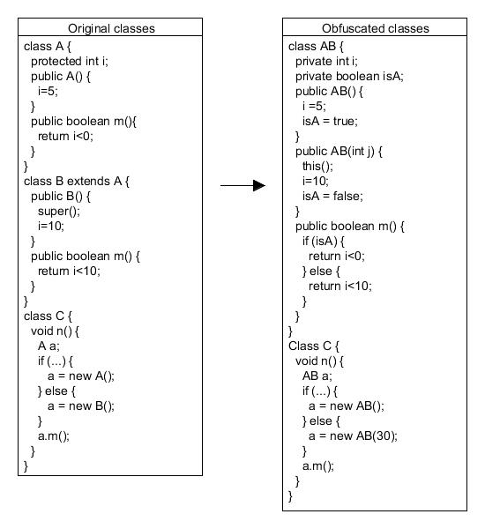
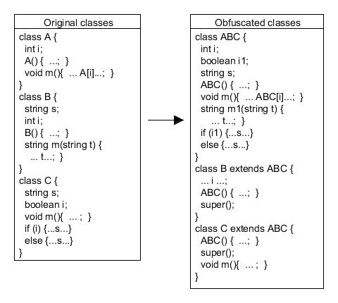
Class Level Transformations
Relocate the frame of program
Class combination
Simple combination
Complex combination
Class promotion
Class splitting

Slide 10
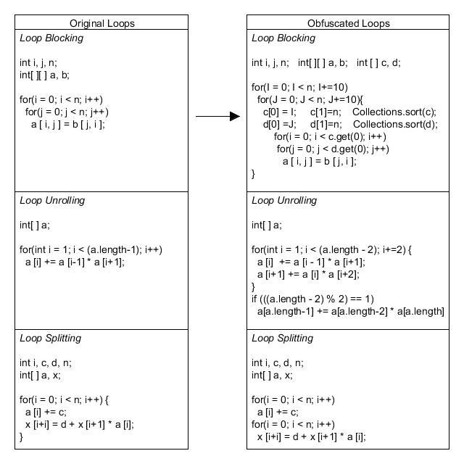
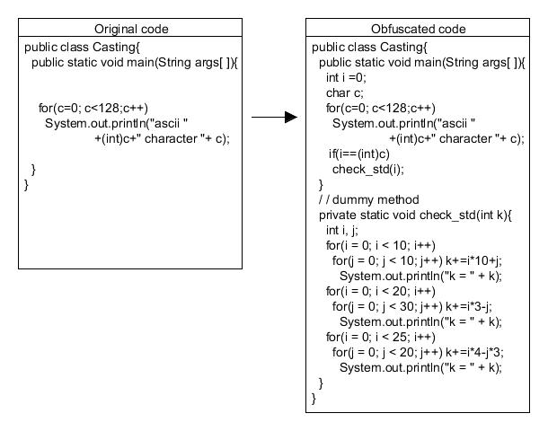
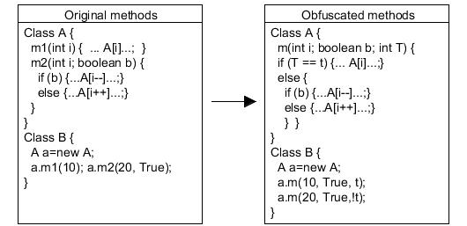
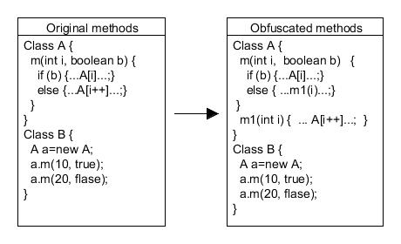
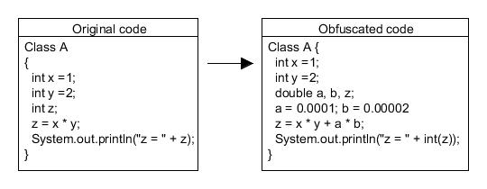
Method Level Transformations
Affect addressing the methods and the control flow of programs
Method Interleaving
Method Splitting
Loop transformation
Add irrelevant code

Slide 11
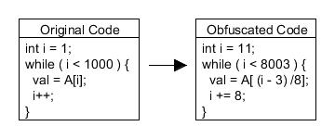
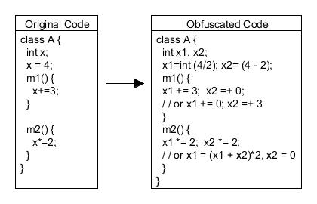
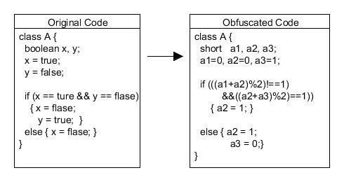
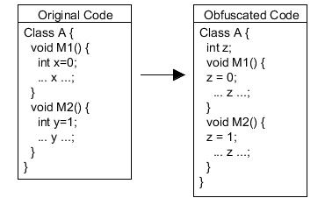
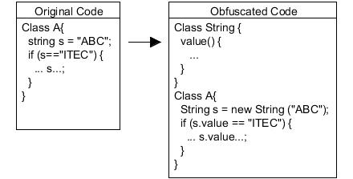
Variable Level Transformations
Operate on the data structures
Change Encoding
Variable promotion
Variable to object
Local variable to global variable
Variable splitting

Slide 12
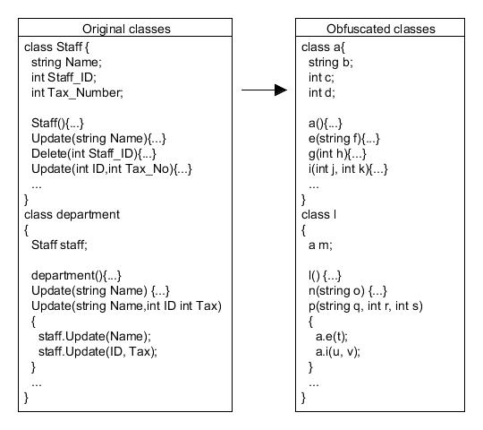
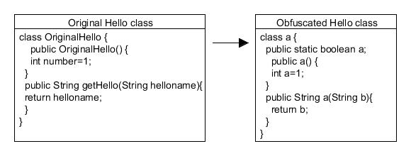
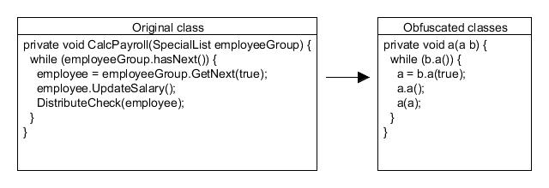
Name Level Transformations
Typically trivial to perform and reduce the amount of information
Layout obfuscation:
Affect the comprehensibility of the program
removing debugging information and comments
renaming identifiers
Name overloading
Same identifier
Different identifier

Slide 13
Agenda
Introduction
Transformations
Conclusion

Slide 14
Discussion
Applying one level’s transformations
may be not very efficiency
E.g. name level transformations, potency but not resilience.
Combine different levels’ transformations
may perform much better
Name level should be applied

Slide 15
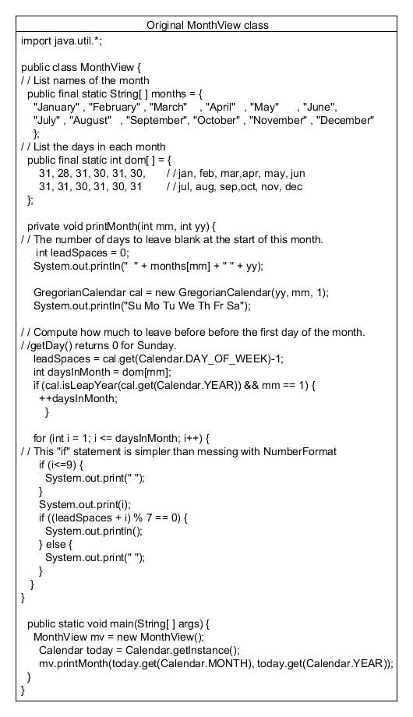
Illustration of Implementation
Viewing current month’s calendar
public class MonthView{
…;}

Slide 16
Implementation (cont.)
Promote the variable to object and class splitting
public class MonthView{
…;}
public class ShowMonth {
…;}
public class MonthNameAndDays

Slide 17
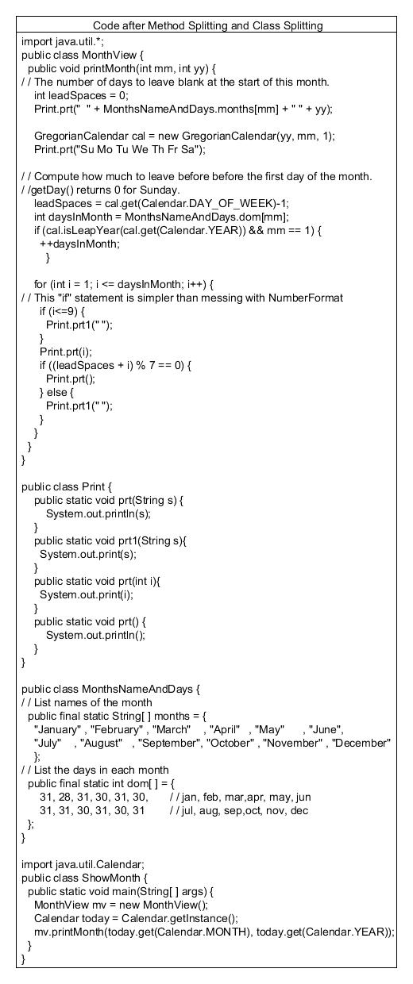
Implementation (cont.)
Method splitting and classing splitting techniques
public class Print {
public static void prt(String s) {
System.out.println(s); }
public static void prt1(String s){
System.out.print(s); }
public static void prt(int i){
System.out.print(i); }
public static void prt() {
System.out.println(); }
}

Slide 18
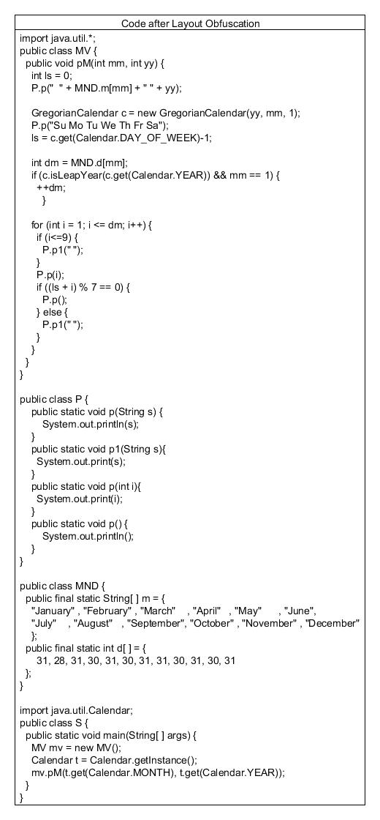
Implementation (cont.)
Layout obfuscation technique
public class MV{…;}
public class P {…;}
public class MND {
String[ ] m; int d [ ];
…;}
public class S {…;}

Slide 19
Implementation (cont.)
Variable splitting and variable promotion
public int ls=0;
public int ls1=1;

Slide 20
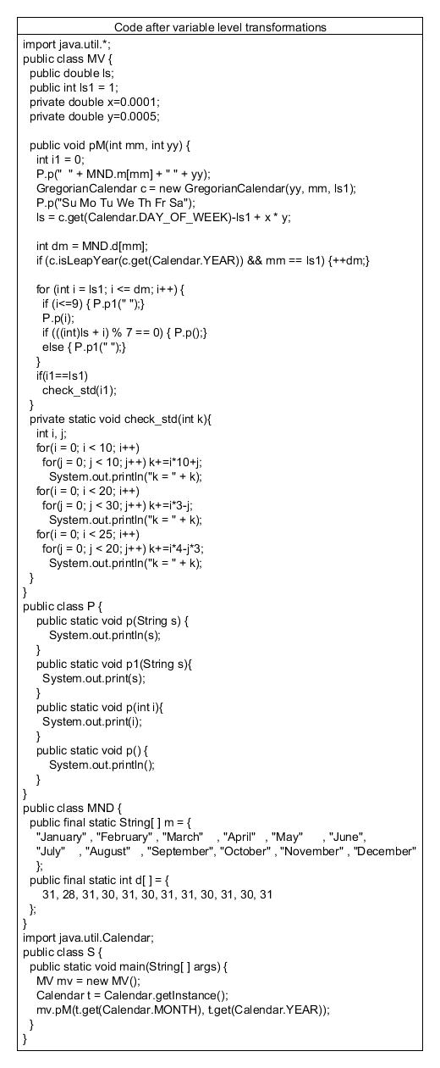
Implementation (cont.)
Adding variables and fingerprint code
public double ls;
public int ls1;
private double x
private double y
private static void check_std(int k) {
…;}

Slide 21
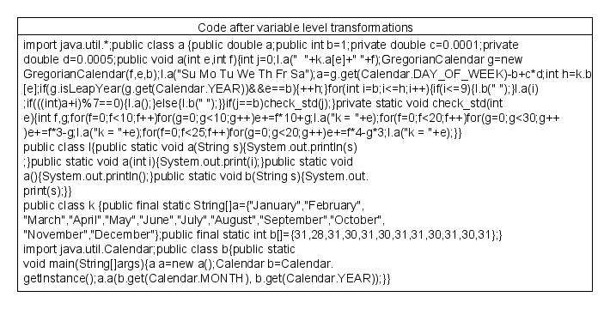
Implementation (cont.)
Name level obfuscation transformation
Same identifier
Remove the layer

Slide 22
Conclusion
Four level transformations
Class level
Method level
Variable level
Name level
Most of them seem to produce acceptable substitutes for original source code
Original and obfuscated codes produce identical behavior

Slide 23
Future recommendation
New obfuscating transformations
Quality of obfuscation
Study of measuring potency, resilience and cost
Does the order matter:
effects of composing obfuscations together
interaction and ordering between different transformations

Slide 24
Question?

