Slide 1
Multicasting in Mobile Ad-Hoc Networks (MANET)
Project Supervisor: Michael Hitchins
Student Id: 41543491
RajKumar Sood

Slide 2
Agenda
Introduction
Issues and Challenges in Multicasting for MANET
Classification of Multicasting Protocols
Simulation Based Comparison
Security Threats and Challenges in MANET
Conclusion

Slide 3
What is Mobile Ad Hoc Network (MANET) ?
Definition
A system of Mobile nodes connected with each other via wireless medium without infrastructure support
Applications
Military battlefield
Emergency rescue
Conferences
Outdoor Internet access on campuses

Slide 4
Why choose Mobile Ad Hoc Network ?
Pros
Cons
Easy Deployment
Cost Effective
Time Effective
Better reachability
Wider accessibility
Network of the Future
Immature
Flow and congestion problems
Security issues
Interoperability

Slide 5
What is Multicasting ?
Definition
Multicasting is efficient mean of providing data from a single source to a group of receivers simultaneously
Benefits for MANETs
Bandwidth Efficiency
Lower network overhead
Lower energy consumption
Reduce communication cost

Slide 6
Issues and Challenges
Dynamic multi hop topology
Constant node movement
Network Resource Usage Efficiency
Scarce bandwidth availability
Power Consumption
Limited power supply in hand held devices
Reliability and Security
Transmission over wireless medium
Quality of Service
Reserve network resources to prevent jitter, packet loss
Mobility
leads to construction of trees and meshes that are not efficient leading to packet loss

Slide 7
Classification of Multicasting Protocols
Proactive Multicast
Reactive Multicast
Table Driven
Every node maintains up to date information
Pros
Low Route acquisition latency
Cons
High Control Overhead
On demand
Routes are created on demand
Pros
Less Control Overhead
Cons
High Route acquisition latency

Slide 8
Classification of Multicasting Protocols
Tree Based Multicast
Tree based Mechanism
Single Path between the source and destination
Uses JOIN TREE messages to construct a tree
Source Tree Based
Tree created by each source
As many number of trees as source
Shared Tree Based
Single multicast tree for all sources
Single tree includes all source nodes

Slide 9
Multicast Tree

Slide 10
Classification of Multicasting Protocols
Mesh Based Protocols
Mesh based Mechanism
Multiple paths between the source and destination
Uses JOIN MESH and JOIN REQUEST messages for mesh construction
Hybrid Protocols
Combination of tree and mesh based protocols
Multiple routing paths
Create non optimal tress due to node mobility

Slide 11
Multicast Mesh

Slide 12
Multicast Ad Hoc On Demand Distance Vector Routing Protocol (MAODV)
On Demand tree based protocol
Discovers multicast route on demand
Involves different stages ,
Multicast Route Discovery (RREQ messages)
Reverse Path Setup (RREQ messages)
Forward Path Setup (RREP messages)
Multicast Route Activation (MACT messages)
Group Hello Messages (GRPH messages)

Slide 13
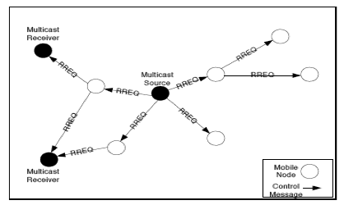
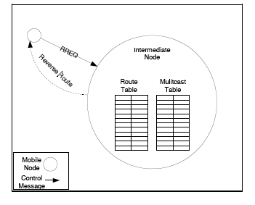
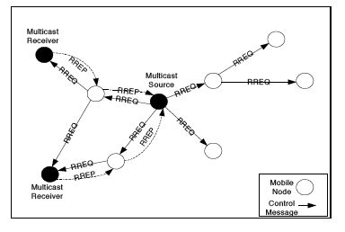
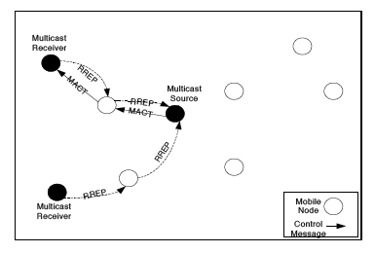
Different Stages
Multicast Route Discovery
Reverse path Setup
Forward Path Setup
Multicast Route Activation

Slide 14
On Demand Multicast Routing Protocol (ODMRP)
On Demand Mesh Based Protocol
Uses the concept of ‘forwarding group’
Floods JOIN QUERY packets
JOIN REPLY packets establish multicast routes & forwarding members

Slide 15
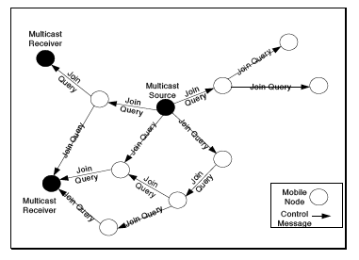
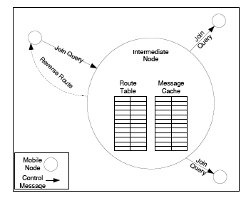
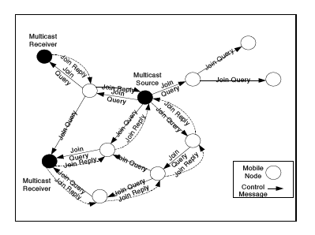
Different Stages for ODMRP
Mesh creation
Join Query Process
Join Reply Process

Slide 16
Qualitative Comparison of MAODV and ODMRP

Slide 17
Simulation Based Comparison
Simulation Parameters

Slide 18
Simulation based Comparison
Network Parameters
Number of Senders
Multicast Group Size
Mobility
Metrics
Packet Delivery Ratio
Control Overhead
Packet Transmission Ratio
Control and Data packets delivered per Data Packet delivered

Slide 19
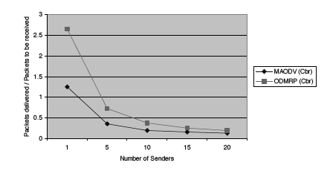
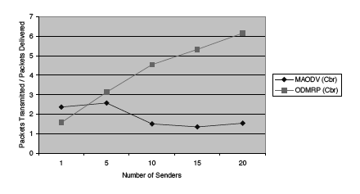
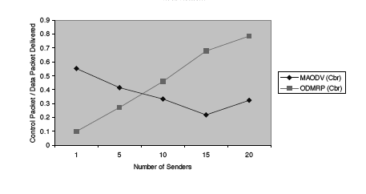
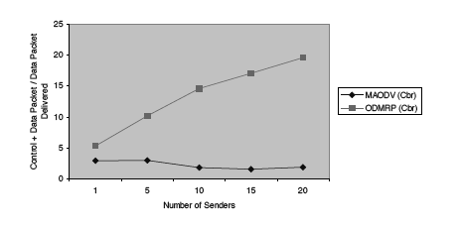
Number Of Senders

Slide 20
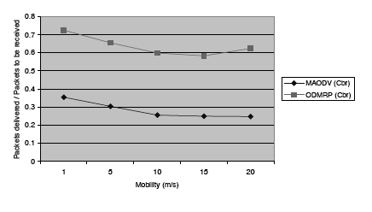
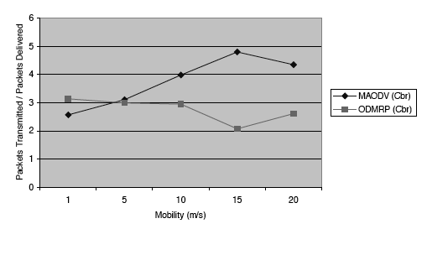
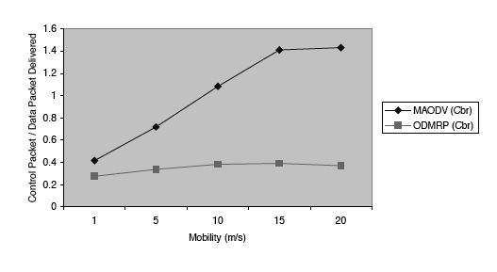
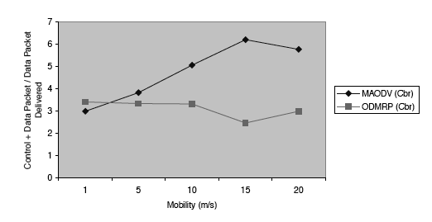
Mobility

Slide 21
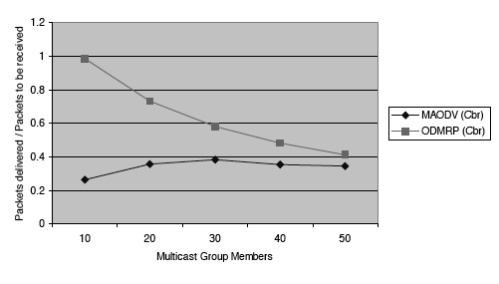
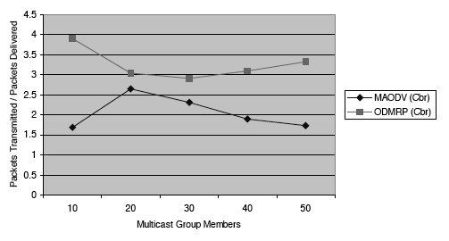
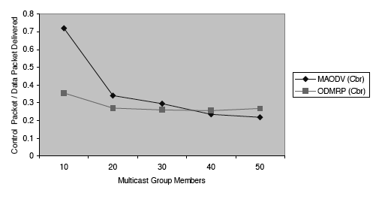
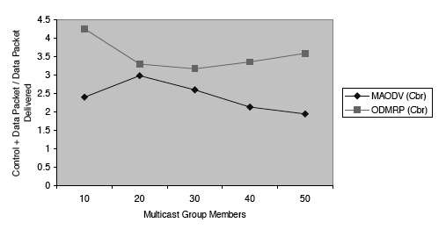
Multicast Group Size

Slide 22
Protocol Analysis
ODMRP has a better packet delivery ratio than MAODV
ODMRP is more robust than MAODV due to minimal packet loss and availability of multiple routes
ODMRP is less scalable compared to MAODV as the number of senders or multicast group size is increased
MAODV has minimal control overhead as compared with ODMRP

Slide 23
Security Threats and Challenges
Types of Attacks
Routing Attacks
Packet Filtering Attacks
Challenges for Security
Peer-to-peer Architecture
Scarce Availability of resources
Node mobility and wireless channels demand more Dynamics in MANET

Slide 24
Conclusions
Multicasting plays a very important role in supporting a variety of applications characterized by close degree of collaboration for MANETS
Mesh based protocols outperform tree based protocols as they are more robust
Usefulness of different protocols depends on the application environment
Multicasting protocols for MANET are in early stages and need further research
Issues like QoS, reliability, security needs to be further investigated

