Slide 1
ITEC 810 - Initial Plan Secure Router Virtualization
Vishal Bharat Sharma
Student ID: 41423682
Supervisor: Dr. Rajan Shankaran

Slide 2
Overview
Introduction
Routers
Related Concepts and Technologies
MultiProtocol Label Switching
General Router Architecture
Functional Components of Routers
Existing Routers Supporting
Architecture of Routers Supporting SRV -1
Security Features
Comparison

Slide 3
Introduction
Aim
To study and analyze Secure Router Virtualization
Importance
Growing Networks & Services
Changing Industry Needs (Current & Future)
Approach
Analyzing Existing Products
Outcome
Comparison of Concepts and Technology used

Slide 4
Routers
Definition
Device which forwards the data packets to their destination on network
Device to connect two different networks
Logical Routers Vs Secure Virtual Routers
Similarity
Software Based
Dissimilarity
Hardware assigned to Secure Virtual Routers

Slide 5
Related Concepts & Tech.
Virtualization
Network Virtualization
Router Virtualization
General Network Concepts
VLAN
VPN
MPLS
ATM

Slide 6
MultiProtocol Label Switching
Technology that provides very high-speed data forwarding between Label-Switched Routers (LSRs)
Reservation of bandwidth
Differing Quality of Service
Label Switch Router (LSR)
Ingress LSR
Egress LSR

Slide 7
General Router Architecture

Slide 8
Functional Components of Router

Slide 9
Existing Routers Supporting SRV
Cisco Systems
Carrier Routing System One
XR 12000 Series
Juniper Networks
TX Matrix Plus with JCS1200 Control System
TX Matrix with JCS1200 Control System

Slide 10
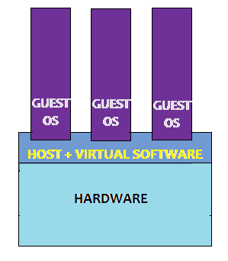
Arch. of Router Supporting SRV -1
Cisco Systems: Carrier Routing System One

Slide 11
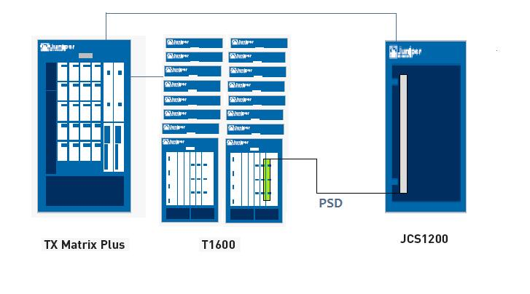
Arch. of Router Supporting SRV -2
Juniper Networks: TX Matrix Plus with JCS1200 Control System

Slide 12
Security Features
Cisco Systems Carrier Routing System One
CISCO IOS XR
Login Access
Access Lists
Juniper Networks TX Matrix Plus
JUNOS
Login Access
Filter Firewalls

Slide 13
Comparison/Summary
Feature | Cisco CRS-1 | Juniper TX Matrix Plus
Hardware | New | Protecting Investment
Software | Microkernel based OS | Modular OS
Performance/Throughput | Up to 92 Tbps | Up to 25 Tbps
OS | Cisco IOS XR | JUNOS
Security Features | Access Control List | Filter Firewalls

Slide 14
Thank You

