Slide 1
Grounded Theory Map of “Innovation Knowledge”
Name: Ms. Hinal Shah
Student ID: 41388577
Supervisor: Dr. Peter Busch
Date: 13th November 2009

Slide 2
Agenda
Theory of Knowledge
Innovation
Grounded Theory
Application of Grounded Theory on Innovation
Conclusion

Slide 3
Theory of Knowledge
Definition of Knowledge – acquaintance with facts, truths. Knowledge could be subjective or objective
Epistemology is a branch of philosophy in the theory of knowledge

Slide 4
Research
Positivism – believe in formulating hypotheses and then testing it for a clearer picture
Interpretivism - ‘explore’ the data first and then come about with a framework
Quantitative - is concerned with numeric data
Qualitative - collecting and analyzing non-numeric data

Slide 5
Innovation
“The act of introducing something new”
Innovation vs Invention – “The three stages in the process of innovation: invention, translation and commercialization”
Why – Primary purpose is to bring ‘change’, competitive advantage
How – Starts with understanding the problem, identifying new ideas, filtering new ideas, design and development

Slide 6
IT Innovation
Innovation in IT
Generating and Adapting Organizations
How can innovation be measured – R&D, patents

Slide 7
Grounded Theory
This theory is developed from the data i.e. data gathering, rather than first creating a hypothesis which is then followed by data collection.
Qualitative research methodology
Steps involved
Data Collection
Marking Text
Grouping
Network Map generation

Slide 8
Memos and Coding techniques
Memo
Coding Techniques
Open Coding
Axial Coding
Selective Coding

Slide 9
Manual VS Software for GT
Manual process
Comparing the software
ATLAS.ti
Nudist

Slide 10
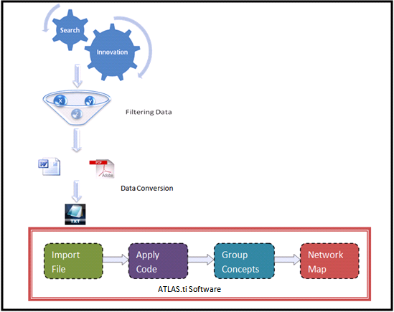
Steps involved in project

Slide 11
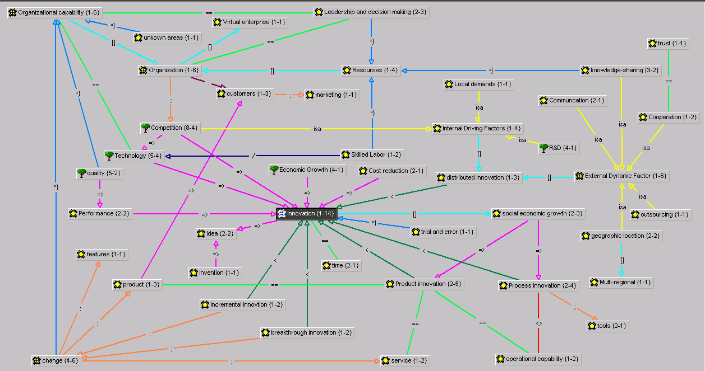
Network Map of Innovation

Slide 12
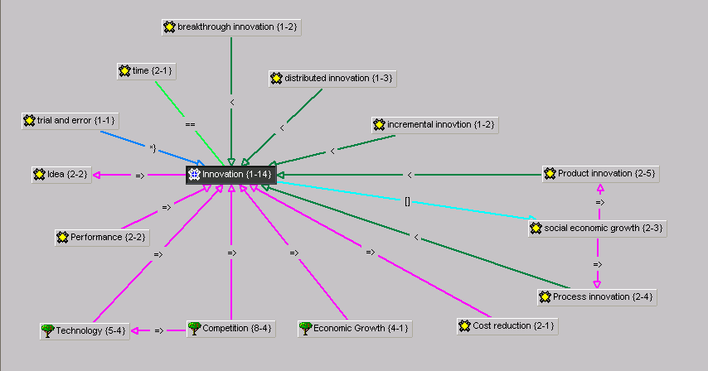
Innovation Node
Types of “Innovation”
Factors that contribute to innovation

Slide 13
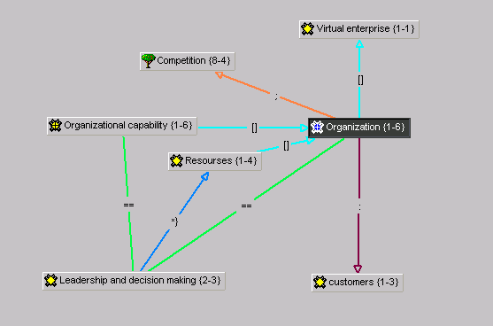
How Organizations play a vital role

Slide 14
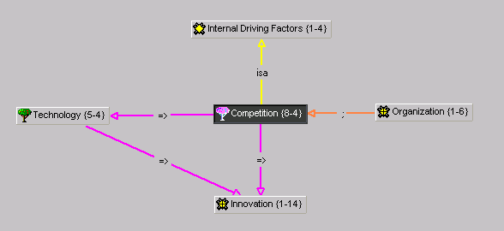
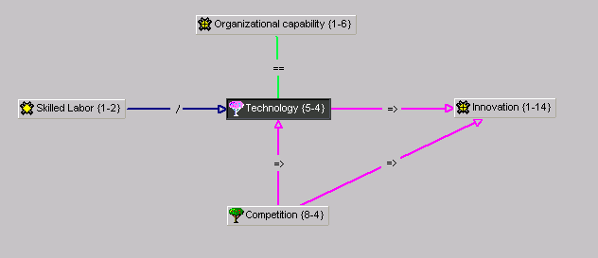
Key Factors that affect Innovation

Slide 15
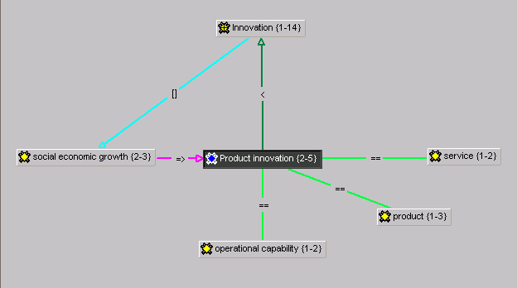
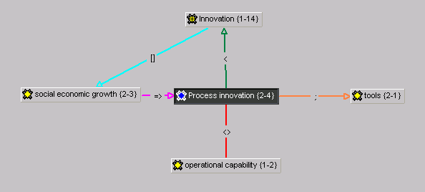
Product and Process Innovation

Slide 16
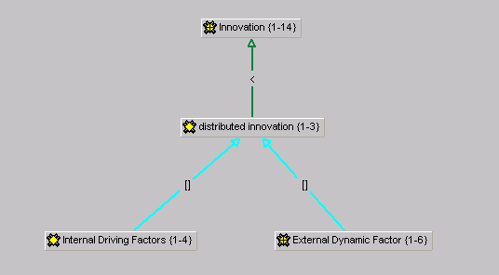
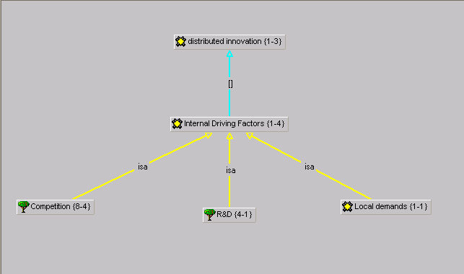
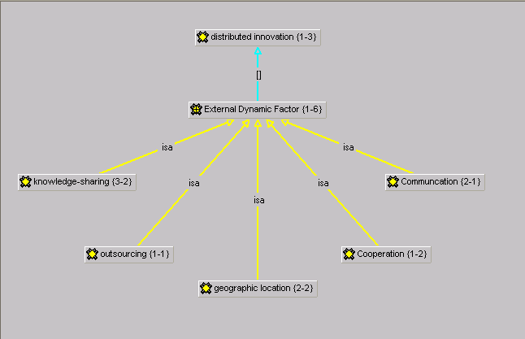
Distributed Innovation

Slide 17
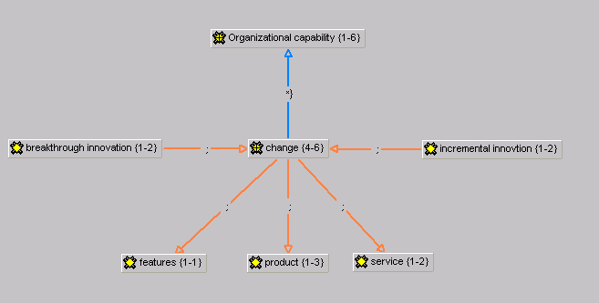
Breakthrough and Incremental Innovation

Slide 18
Conclusion
Innovation knowledge
Grounded theory benefits
Future Work

Slide 19
Thank You

