Slide 1
Overview of Micropayment Technology
Student
Fabio Alexandre Rodrigues
ID. 41308611
Supervisor
DR Josef Pieprzyk
Notes:
Micropayments is basically payments transactions for small amount of money (replacing wallet cash) and with a small cost per transactions

Slide 2
Agenda
Introduction
Micropayment Characteristics
Basic View of Micropayment Schemas
PayWord Schema
Singapore Public Transport - Case Study
Emerging Micropayments
Conclusion

Slide 3
1. Introduction
Problem
Increased popularity of micropayments
(+50% by Hi-Media, 2009)
Social acceptability is growing especially for young generations
Difficulty to trace criminals
Weakness confirmed by real-life security violations
Goals
Review of existing and emerging micropayment system
Analysis of their strengths and weaknesses
Discussion of social aspects of micropayments
Case study analysis
Notes:
>Electronic environment makes difficult to trace criminals;
>Records of micropayments violations;
>Young generation is more technology oriented as in some cultures

Slide 4
Agenda
Introduction
Micropayment Characteristics
Basic View of Micropayment Schemas
PayWord Schema
Singapore Public Transport - Case Study
Emerging Micropayments
Conclusion

Slide 5
2. Micropayment Characteristics
Untraceability
Anonymity
Scalability
Security
Double Spending Detection
Validation
Token Based or Account Based

Slide 6
2.1 Micropayment Characteristics

Slide 7
2.2 Micropayment Characteristics

Slide 8
Agenda
Introduction
Micropayment Characteristics
Basic View of Micropayment Schemas
PayWord Schema
Singapore Public Transport - Case Study
Emerging Micropayments
Conclusion

Slide 9
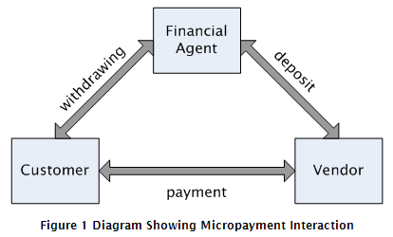
3. Basic View of Micropayment Schemas
Customer’s View
Withdrawing
Payment
Vendor’s View
Payment
Deposit (Rendemption)
Financial Agent’s View
Withdraing
Deposit

Slide 10
Agenda
Introduction
Micropayment Characteristics
Basic View of Micropayment Schemas
PayWord Schema
Singapore Public Transport - Case Study
Emerging Micropayments
Conclusion

Slide 11
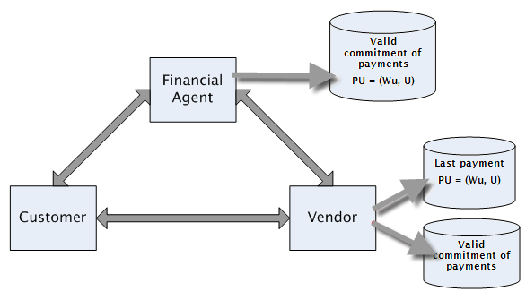
4. PayWord Schema
Certifying Phase
Commitment
Payment Phase
Deposit Phase
Notes:
Growing trends to services using these mechanisms also impacts on the user acceptability

Slide 12
Agenda
Introduction
Micropayment Characteristics
Basic View of Micropayment Schemas
PayWord Schema
Singapore Public Transport - Case Study
Emerging Micropayments
Conclusion

Slide 13
5. Singapore Public Transport
EZ-Link RFID card
Successful Micropayment Project with more than 8 Million Cards
Smart Fare Calculation for Buses and Trains
Easy Operation on the Gates
EZ-Link CEPAS Card, New Generation
Type of EZ-Link
Standard Card
Identification
Concession
Use of the Cards
Trains, Buses, Boats, Taxis, Fast Food, Schools’ Canteen, School Attendance, so on.

Slide 14
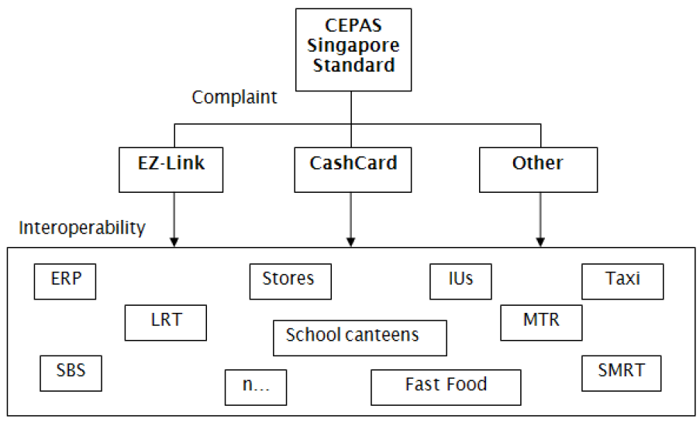
5.1 Singapore Public Transport

Slide 15
Agenda
Introduction
Micropayment Characteristics
Basic View of Micropayment Schemas
PayWord Schema
Singapore Public Transport - Case Study
Emerging Micropayments
Conclusion

Slide 16
6 Emerging Micropayments
Mobile Payments (expectation of growing 10 x 2008-2013)
Existing Types of Implementations:
SMS – Short Message Service
NFC – Near Field Communication
Mobile billing account
Social Network Payment
Facebook credit (expecting income for 2009 about $500m)
Twitter with Twitpay schema

Slide 17
Agenda
Introduction
Micropayment Characteristics
Basic View of Micropayment Schemas
PayWord Schema
Singapore Public Transport - Case Study
Emerging Micropayments
Conclusion

Slide 18
7 Conclusion
Reviewed Existing and Emerging Micropayment Solutions
Analyzed a Case Study: Singapore
Social Aspects of a New Technology
Less and Most Promising Micropayment
Notes:
. What I have done here
. Implementation Problems off risk, Technical Solutions Affecting Security, Efficiency and User Acceptability

