Slide 1
MS Exchange multi hosting web portal
Sebastien Quinternet – 41552016
Project supervised by Michael Johnson

Slide 2
Presentation outlines
1 - Introduction
Background / Objectives / Outlines
2 - Related projects
3 - Server’s administration
4 - Web Platform
5 - Test and feedback
6 - Conclusion

Slide 3
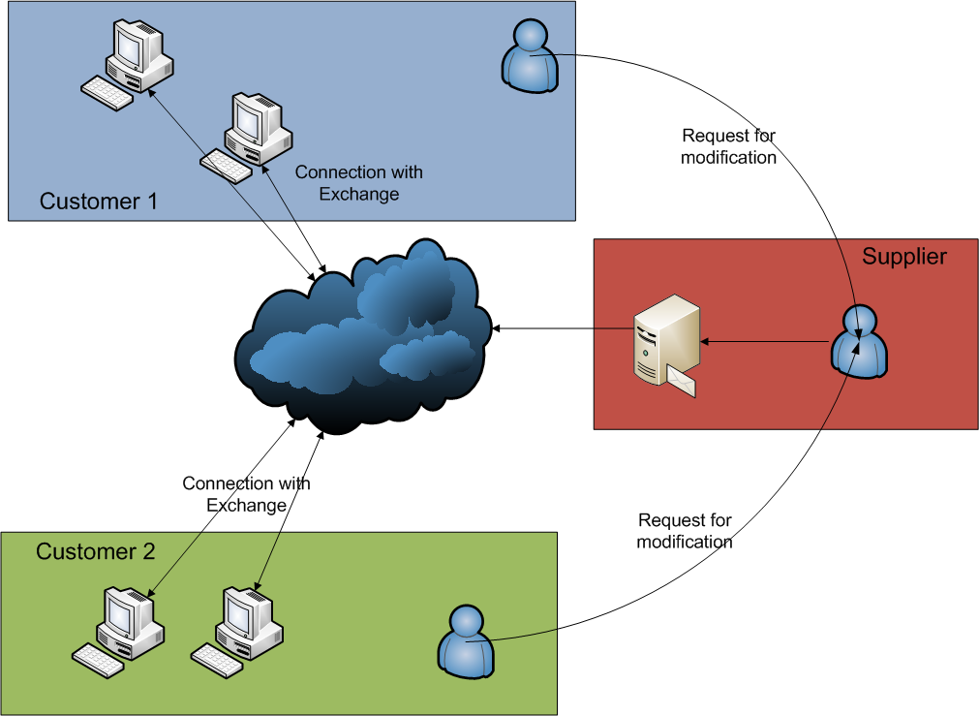
1 – Introduction / Background
Customer depends on the supplier
Long time process
Risk of error

Slide 4
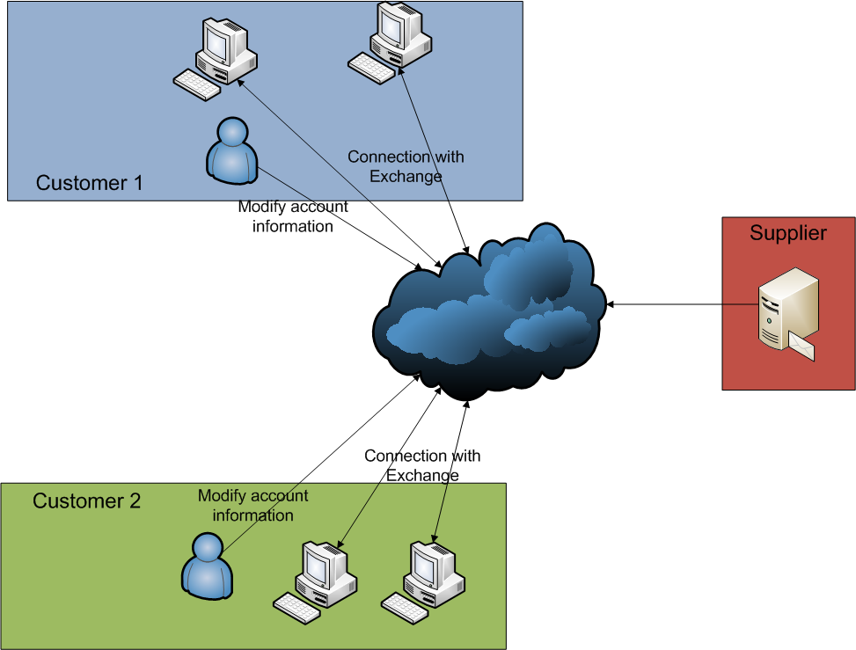
1 – Introduction / Objectives
Direct access to Active Directory
Web portal
Main requirement
Easy to use

Slide 5
1 – Introduction / Outcomes
Gain of flexibility for the customers
Real time modification of the data
Reduction of manual modifications

Slide 6
Presentation outlines
1 - Introduction
2 - Related projects
Corendal Directory / ADManager Plus
3 - Server’s administration
4 - Web Platform
5 - Test and feedback
6 - Conclusion

Slide 7
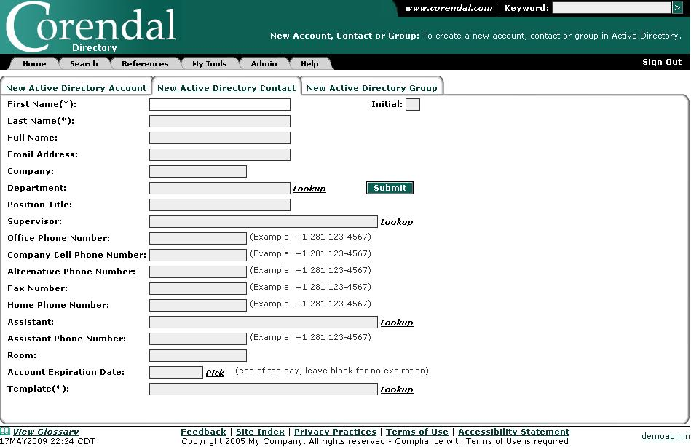
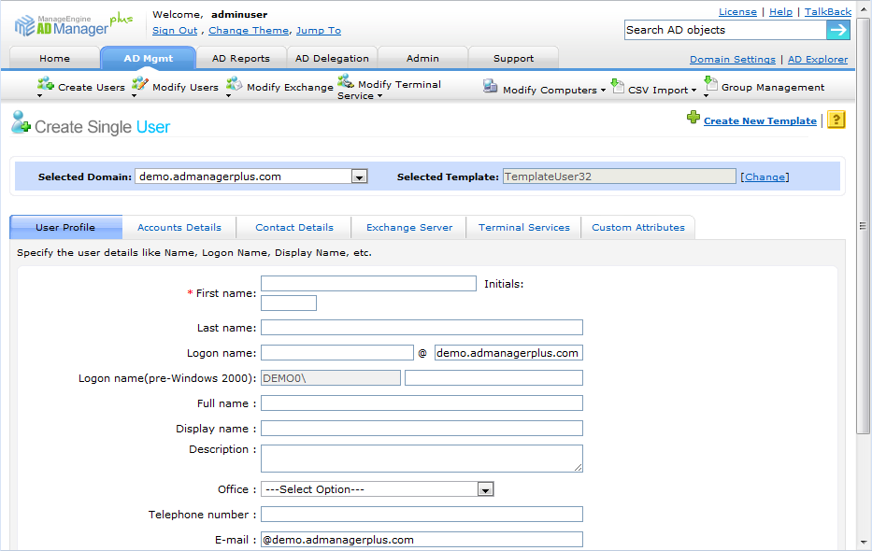
2 - Related projects
“This open source application is typically used by help desk analysts and active directory administrators as part of their daily account, contact and group management tasks.”
(http://www.corendal.com/products/corendal-directory)
“ADManager Plus is a simple, easy-to-use Windows Active Directory Management and Reporting Solution that helps AD Administrators and HelpDesk Technicians with their day-to-day activities”
(http://www.manageengine.com/products/ad-manager/)

Slide 8
Presentation outlines
1 - Introduction
2 - Related projects
3 - Server administration
4 - Web Platform
5 - Test and feedback
6 - Conclusion

Slide 9
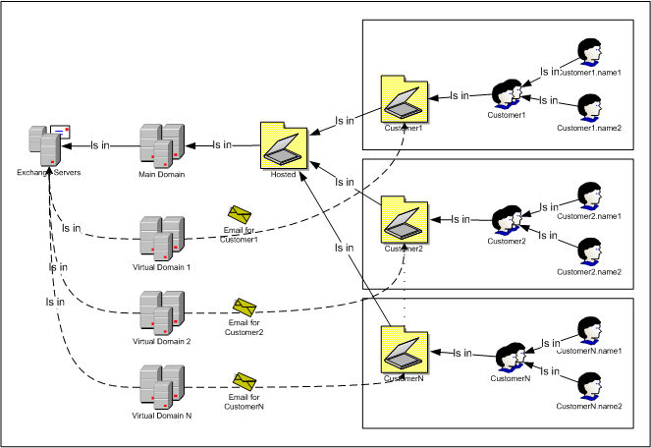
3 - Server’s administration
AD design
Independent OU
Isolated OU
GALs configuration
Email distribution
Email distribution
Virtual domains

Slide 10
Presentation outlines
1 - Introduction
2 - Related projects?
3 - Server’s administration
4 - User Platform
Web Interface / Email Automate
5 - Test and feedback
6 - Conclusion

Slide 11
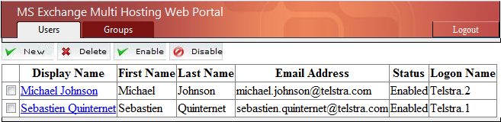
4 - Web Platform / Web Interface
Users of the company
Auto generated Logon Name

Slide 12
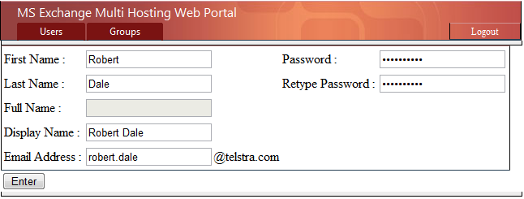
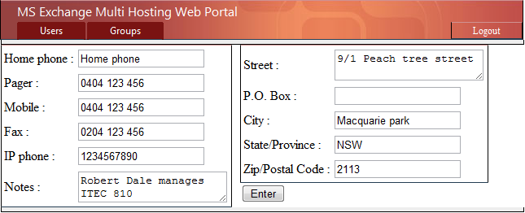
4 - Web Platform / Web Interface
Email information
robert.dale@telstra.com
Contact information

Slide 13
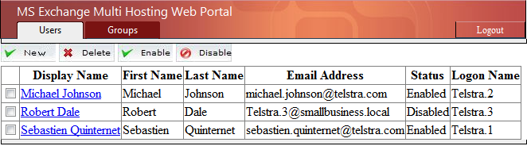
4 - Web Platform / Web Interface
Invalid email address
robert.dale@telstra.com -> Telstra.3@smallbusiness.local

Slide 14
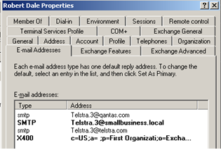
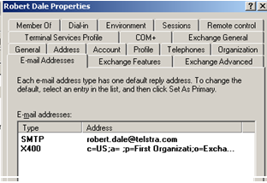
4 - Web Platform / Email Automate

Slide 15
4 - Web Platform / Email Automate
Use as a service
Loop every 5 seconds
<?xml version="1.0" encoding="utf-8"?>
<Users>
<User ID="CN=Robert Dale,OU=Telstra,OU=Hosted,DC=smallbusiness,DC=local">
<Email>robert.dale@telstra.com</Email>
<OU>Telstra</OU>
</User>
</Users>

Slide 16
Presentation outlines
1 - Introduction
2 - Related projects?
3 - Server’s administration
4 - Web Platform
5 - Test and feedback
6 - Conclusion

Slide 17
5 - Test and feedback
Personal tests
Test functionalities using checklist
IT student feedback
Interesting project which needs more features
Non IT student feedback
Hard to understand if out of the context

Slide 18
Presentation outlines
1 - Introduction
2 - Related projects?
3 - Server’s administration
4 - Web Platform
5 - Test and feedback
6 - Conclusion

Slide 19
6 - Conclusion
Environment of the project
MS Exchange multi-hosting
Problem related
Complicated process
How to resolve it
Web portal
Outcomes
Flexibility / Real time modification / Security

