Slide 1
An Analysis of the Scheduling of Tutorials and Practicals
Karen McGirr
karen.mcgirr@students.mq.edu.au
Supervised by Dr. Abhaya Nayak

Slide 2
Agenda
Introduction to Timetabling
Why are Tutorials and Practicals a Problem?
How a Timetable is Made
How Staff are Assigned
Available Timetabling Tools
Conclusions and Recommendations

Slide 3
Timetabling Research Fields

Slide 4
Terminology
Curricula – Units required to qualify for degree
Unit - the Course or Subject
Offering – Units may be ‘offered’ in several modes in an academic year
Activity – A type of lesson for a Unit
Class – A scheduled lesson for a Unit

Slide 5
The Problems within Timetabling
A simple view:
School Scheduling
Course Scheduling
Examination Scheduling
A more refined view:
Class-Teacher Timetabling
Streaming
Course Timetabling
Room Assignment
Staff Assignment
Student Scheduling
Examination Timetabling
Invigilator Assignment

Slide 6
Agenda
Introduction to Timetabling
Why are Tutorials and Practicals a Problem?
How a Timetable is Made
How Staff are Assigned
Available Timetabling Tools
Conclusions and Recommendations

Slide 7
The Structure of an Academic Timetable

Slide 8
Why is it so hard?
INFT11P - Information Systems - minor project (Postgraduate Study Pattern)
ITEC870 Advanced Database Applications Development
and
ITEC871 Information Systems Design and Management
and
ITEC810 Information Technology Project
and some of these
ITEC800 Systems Engineering Process
ITEC821 Requirements Engineering
ITEC830 XML Technologies
ITEC832 Enterprise Application Integration
ITEC841 Project and Risk Management
ITEC872 Data Mining and Business Intelligence
and others
Curricula Clashes
Assigning Rooms

Slide 9
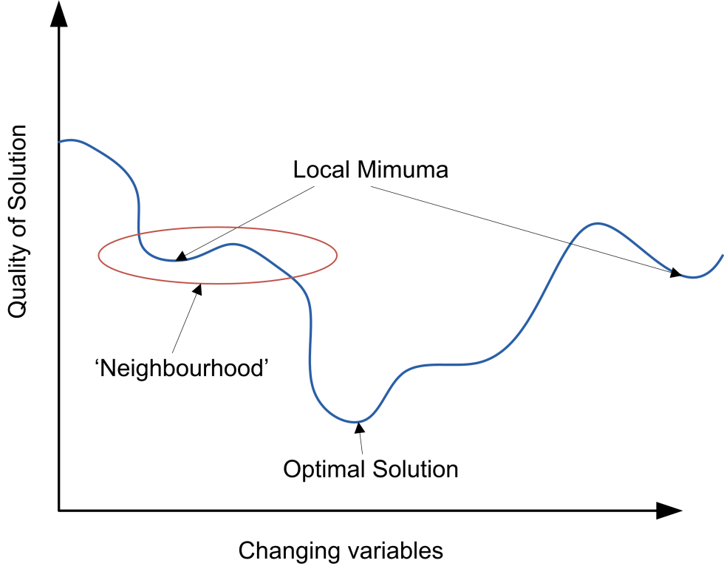
Algorithms in use
Local Search
Simulated Annealing
Genetic Algorithm
Tabu Search
Constraint Logic Programming

Slide 10
Constraints
Hard Constraints
Room capacity must exceed class size
One lesson per room per period
Soft Constraints
Room capacity should be the smallest possible to accommodate the class size
The Faculty may indicate room preferences

Slide 11
Agenda
Introduction to Timetabling
Why are Tutorials and Practicals a Problem?
How a Timetable is Made
How Staff are Assigned
Available Timetabling Tools
Conclusions and Recommendations

Slide 12
The Concept of Streaming
The Students enrolled in an offering may need to be subdivided because:
Smaller class sizes for some activities
Rooms not available to fit the entire group
Local idiosyncrasies

Slide 13
Why does this cause problems?
Large numbers of Streams
Econ 110 had 58 streams scheduled!
Each streamed class needs a room (and a teacher)
But streamed classes can be scheduled concurrently!

Slide 14
How are these problems addressed?
Schedule carefully
Concurrent streams need different rooms (and teachers)
Extra staff to teach streamed lessons

Slide 15
Agenda
Introduction to Timetabling
Why are Tutorials and Practicals a Problem?
How a Timetable is Made
How Staff are Assigned
Available Timetabling Tools
Conclusions and Recommendations

Slide 16
The process of Timetabling

Slide 17
The Process in Practice
Rollover previous year
Shuffle rooms for changed enrolment levels
Out with the old in with the new
Assign teaching staff
Change to accommodate staffing issues
Enrol Students
Change to accommodate actual enrolment levels

Slide 18
Agenda
Introduction to Timetabling
Why are Tutorials and Practicals a Problem?
How a Timetable is Made
How Staff are Assigned
Available Timetabling Tools
Conclusions and Recommendations

Slide 19
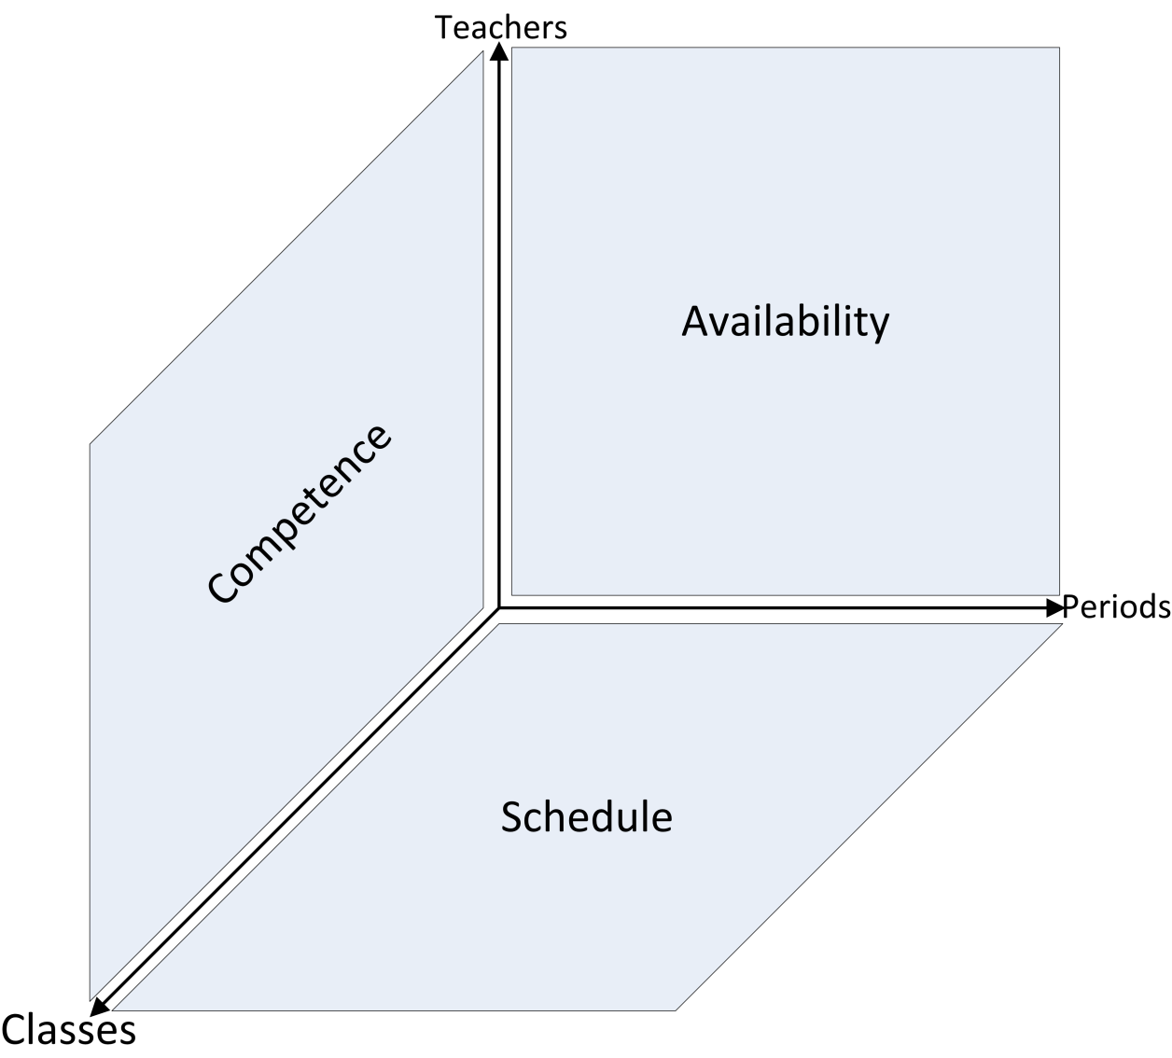
What influences Staff Assignment?
Class Schedule
Staff Availability
Staff Competence

Slide 20
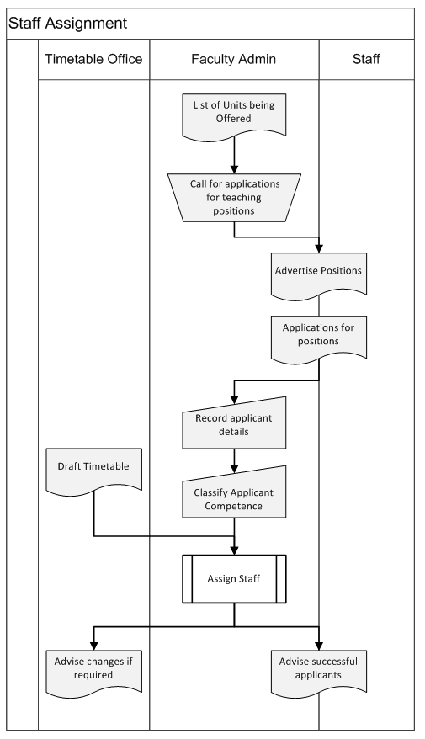
The Staff Assignment Process
Plan offerings
Call for applicants for the planned classes
Rank applicant’s competence
Allocate ‘best fit’ with draft timetable
Advise Timetabling Office of issues

Slide 21
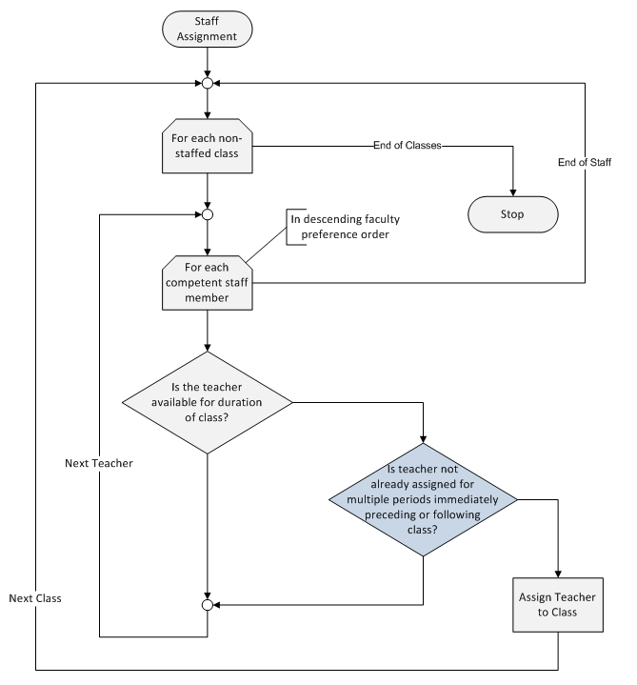
How do we determine ‘Best Fit’?

Slide 22
Agenda
Introduction to Timetabling
Why are Tutorials and Practicals a Problem?
How a Timetable is Made
How Staff are Assigned
Available Timetabling Tools
Conclusions and Recommendations

Slide 23
What does Macquarie University Use?
TTMaker™ timetabling software
Vendors have vanished
Doesn’t handle all offerings
Doesn’t handle staff assignment

Slide 24
Timetabling Software Survey
36 Products Surveyed
7 Products Tested

Slide 25
Agenda
Introduction to Timetabling
Why are Tutorials and Practicals a Problem?
How a Timetable is Made
How Staff are Assigned
Available Timetabling Tools
Conclusions and Recommendations

Slide 26
Agenda
Introduction to Timetabling
Why are Tutorials and Practicals a Problem?
How a Timetable is Made
How Staff are Assigned
Available Timetabling Tools
Conclusions and Recommendations

Slide 27
Conclusions
Staff Assignment is not a priority for research
MQ’s current software inadequate
Recommend either new software or an add-on tool
Products to investigate
iMagic Timetable Master
INFOSILEM EnCampus
O!Timetabling

