Slide 1
An Analysis of Stream Processing Languages
Student Name: Miran Dylan
Itec810
Supervisor: Mehmet A. Orgun

Slide 2
Today’s Agenda
Introduction
Issues / Features of Stream Processing Language
System and Languages
Conclusion

Slide 3
Introduction
What is Stream Processing?
data-intensive and real-time applications.
data generated continuously (growing rapidly)

Slide 4
Stream processing applications
Where Stream Processing used ?
DSMS and SPE:
  telecom call-records
  network security
  financial applications
  sensor networks
  manufacturing processes

Slide 5
DBMS versus DSMS
One-time queries
Random access
Only current state matters
Passive repository
No real-time services
Continuous queries
Sequential access
History/arrival-order is critical
Active stores
Real-time requirements

Slide 6
Query Example
    DBMS Query
    When the temperature dropped below X
    when was the prices of stock Y >$20
    DSMS Query
    Notify me when the temperature drops below X
    Tell me when prices of stock Y > $20

Slide 7
DSMS bench mark
Linear Road Benchmark ( simulation prototype)
variable tolling system that charges vehicles different toll rates
Example Query in Linear Road
Notify me when there is an accident on the freeway

Slide 8
Today’s Agenda
Introduction
Issues / Features of Stream Processing Language
System and Languages
Conclusion

Slide 9
Issues and Features
Low latency of data
processing data instantly – real time
event driven processing to avoid polling data
Minimize costly storage
Enabling data independency
separating data from the application
high level declarative languages such as SQL

Slide 10
Issues and Desired Features
Dealing with incomplete streams of data
Data might be delayed, out of order or missing
Time-out individual uncompleted process
extending processing time
Providing predictable output
discover changes –estimating techniques
Important for fault tolerance and recovery

Slide 11
Issues and Features
Integrating stored and stream data
access and modification stream data and historical data in the same manner
ability convert between the two types using a unified way
Guaranteeing high availability
high up time
parallel processing

Slide 12
Issues and Features
Automatic scalability and resource utilization
balancing resources
distribution processors – multi processing
Load Balance across machines
Supporting complex event processing
monitor processing
pattern matching

Slide 13
Today’s Agenda
Introduction
Issues / features of Stream Processing Language
System and Languages
Conclusion

Slide 14
Aurora - Borealis
Based on data-flow approach
Employ a Quality of Service graphs for monitoring
Uses continuous query SQuAl (Stream Query Algebra)
based on well defined operators
Borealis next generation of Aurora built on Distributed environment

Slide 15
STREAM
general purpose centralized single system
continuous query language CQL
Employ several operators
Queries issued declaratively and translated into query plans

Slide 16
StreamBase
Commercial DSMS
Tuple driven model
StreamSQL : graphical event flow programming language
Support low-latency
High availability via standard process pairs approach of two dedicated servers

Slide 17
SPADE
declarative stream processing engine (IBM)
generic built-in stream processing operator
Based on infrastructure of stream processing core SPC of Distributed system S

Slide 18
Today’s Agenda
Introduction
Issues / features of Stream processing Language
System and languages
Conclusion

Slide 19
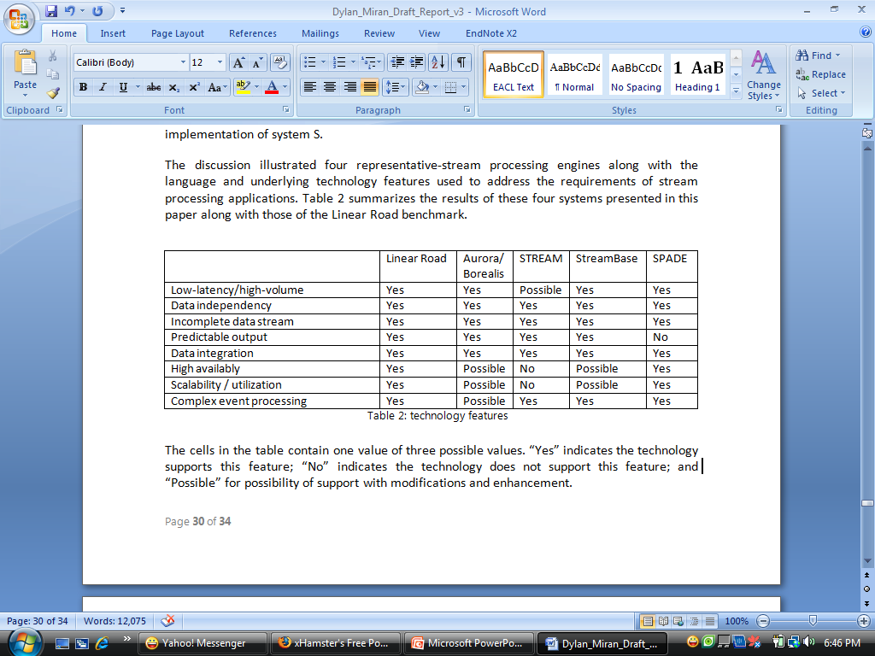
Comparison of the technologies

Slide 20
Conclusion
DSMS different from HDS
Stream processing languages emerged from different applications requirements
Not all languages used by stream processing engines have the same characteristics as some are stronger in certain areas while others are not.

Slide 21
Thank you
Questions ?

