Slide 1
Pro-MOTE:
A 3-D Whiteboard
For
Scientific Collaboration
Shweta Jain

Slide 2
Agenda
Motivation
ProMOTE Introduction
Architectural Choices
Pro-MOTE system Architecture
Experimentation
Conclusion and Future Work
Acknowledgement

Slide 3
Motivation
Scientific Collaboration
  - Accelerates Innovation
  - Distant communication is key for collaboration
Current Communication Technologies
  - Text/Voice/Video based communication is lacks shared platform
  - Whiteboard based communication target 2-D environment

Slide 4
ProMOTE is..
An Interactive 3-D whiteboard.
Uses gesture recognition based Human Machine Interface.
Helps deliver better interactive experience

Slide 5
Architectural Choices
Typical Gesture Recognition System has..
Primarily Three Components:
- Motion Capture Device
- Motion/Gesture interpretation system/software.
- Gesture controlled device of system

Slide 6
Architectural Choices...
Motion Capture
  Vision Based
    Needs elaborate setup
    Needs complex computer vision algorithms.
    Hinders human movement due to camera positioning.
    Dependent on environment conditions.
  EMG Based
    Requires users to wear many sensors.
    Susceptible to noise.

Slide 7
Architectural Choices...
Motion Capture....
  Movement Based
    Reasonable accuracy
    Requires minimal setup, requires user to hold a “wand” or wear a “Glove”
    Glove-based systems can track each finger movement.
    “wand” based systems can track in 3-D, which is sufficient for a 3-D whiteboard.
  We Chose WiiMote => A Wand with movement based motion capture.

Slide 8
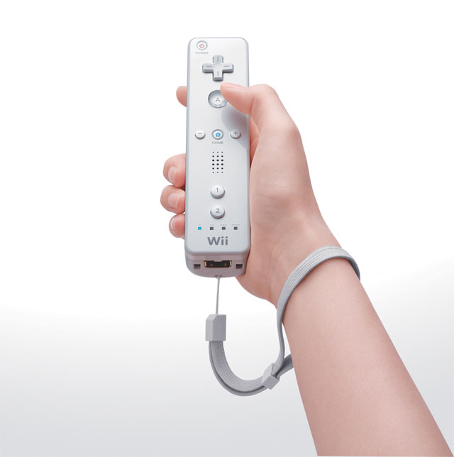
Architectural Choices.. WIIMOTE

Slide 9
Architectural Choices
Gesture Recognition
  Python or C++
    Needs integration of wiimote drivers.
    Needs wiimote based libraries.
  GlovePIE
    Pre-configured to support wiimote.
    Freeware. Universally used.
    Can control various interface of windows system, including the mouse pointer.

Slide 10
Architectural Choices
Gesture Recognition
  Python or C++
    Needs integration of wiimote drivers.
    Needs wiimote based libraries.
  GlovePIE
    Pre-configured to support wiimote.
    Freeware. Universally used.
    Can control various interface of windows system, including the mouse pointer.

Slide 11
Architectural Choices
3-D recreation
    OpenGL based systems
      Requires extensive programming.
    Vizard
      Easy to use and script.
    Blender
      Freeware.
      Universally accepted.

Slide 12
Pro-Mote System Architecture
I
N
T
E
R
N
E
T
Motion Capture
[WIIMOTE]
Recognition
[GlovePIE]
3 – D View
3-D recreation [Blender]
USER -1
Motion Capture
[WIIMOTE]
Recognition
[GlovePIE]
3 – D View
3-D recreation [Blender]
USER -2

Slide 13
Experimentation
Lab Experiments were shown to:
  Connect the wiimote to the GlovePIE.
  Have GlovePIE control wiimote.
  Have Wiimote act as a mouse emulator.
  Have Wiimote control Blender Menus, to draw, edit and manipulate 3-D objects.
  Use Wiimote to do freehand 3-D drawing of objects on a blender based whiteboard.

Slide 14
Experimentation....
Real world experiments require:
  Human Ethics Committee approval. We already have it.
  Needs a setup where multiple users far away can communicate using Pro-MOTE.
  Users will be given a Questionnaire to obtain their feedback on Pro-MOTE experience as compared to conventional collaborative systems.

Slide 15
Conclusion and Future Work
Prototype System was shown to
  Capture Wiimote commands and Gestures
  Convert them into Blender commands
  Recreate objects or diagrams with Blender
In Future, we propose to
  Support more shapes, and figures.
  Use Nvidia 3-D vision [Combination of 3-D viewing Eyewear and a special LCD screen] for virtual 3-D viewing experience.

Slide 16
Acknowledgements
Thanks to my advisor Manolya Kavalki for help and motivation.
Thanks to the class of ITEC810 for their support.
Thanks to Robert Dave for useful feedback.
And.. Thanks to you all for patiently listening.. !!

Slide 17
Qns ?

