Slide 1
Game Theory in Business Collaboration
Gabriel Tsang
Supervisor: Jian Yang

Slide 2
Agenda
Initial Problem
Related Work
Approach
Outcome
Conclusion
Future Work

Slide 3
Agenda
Initial Problem
Related Work
Approach
Outcome
Conclusion
Future Work

Slide 4
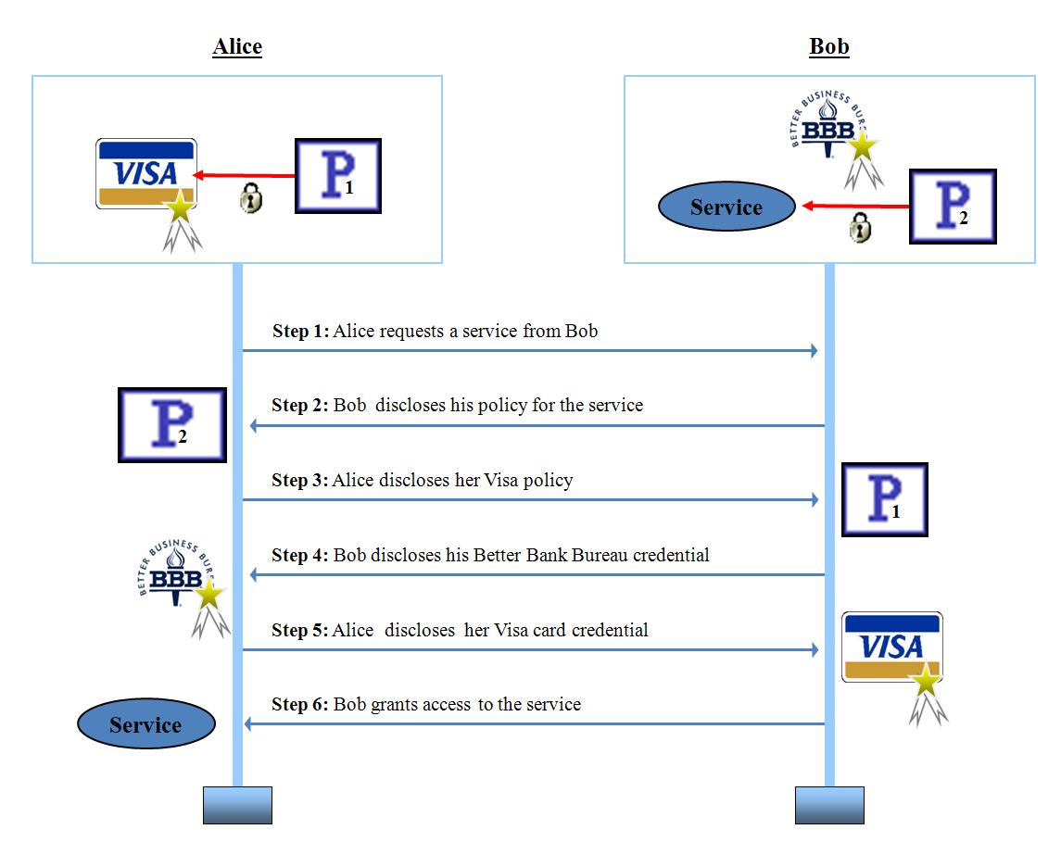
Background

Slide 5
Initial Problem
business process involves multiple business partners
increasingly outsourcing key operations and interaction
often need to share resources to accomplish a common task
Negotiation of Access Control required
Use Game theory to model
obtain a better strategy
Notes:
Game Theory chooses a better strategy
maximise their quality or profit
the solution selecting process becomes complicated.
applied Game Theory to Business Collaboration

Slide 6
Agenda
Initial Problem
Related Work
Approach
Outcome
Conclusion
Future Work

Slide 7
Related Work
Business Collaboration
  Overview, Characteristics and Challenges
Game Theory
  Model Basic elements,Business Applications

Slide 8
Business Collaboration Overveiw
Before seeking partners to cooperate with an enterprise will first need to capture its private behavior in the internal business process aspect.
Based on its internal behavior the enterprise can then specify its capabilities in its externally visible behavior in the participant public behavior aspect.
Enterprise negotiates with other parties to establish cooperation.

Slide 9
Business Collaboration Characteristics
Long-time execution.
Heterogeneous and autonomous business process communication among multiple business participants.
cross-organisational asynchronous business interaction.
Complex business-oriented transactional semantics.
Cross-organisational policy coordination.

Slide 10
Business Collaboration Challenges
Trust
Technologies

Slide 11
Access Control Policies
Credential disclosure is governed by an access control policy
  Specifies credentials that must be received from another party prior to disclosing the sensitive credential to that party

Slide 12
Game Theory elements – part 1
Players: The decision makers in the game.
Actions: Choices available to a player.
Information: Knowledge that a player has when making a decision.
Strategies: Rules that tell a player which action to take at each point of the game.

Slide 13
Game Theory elements – part 2
Outcomes: The results that unfold, such as a price war, world peace, etc.
Payoffs: The utilities (or happiness) that each player realizes for a particular outcome.
Equilibria: An equilibrium is a stable result.

Slide 14
Game Theory applications
Supply Chain Management
Wireless Network
Artificial Intelligent

Slide 15
Agenda
Initial Problem
Related Work
Approach
Outcome
Conclusion
Future Work

Slide 16
Approach
Define Assumptions
Analyse Game Model Using the Framework
Analyse other Game types characteristics
Analyse Critical Factors
  (business collaboration challenge situation)
Map with the Game Model

Slide 17
Assumptions
Each decision maker ("PLAYER“) has available to him two or more well-specified choices or sequences of choices.
Every possible combination of plays available to the players leads to a well-defined end-state that terminates the game.
A specified payoff for each player is associated with each end-state.
Each decision maker does not have perfect knowledge of the game and of his opposition; that is, he does not know in full detail the rules of the game as well as the payoffs of all other players.
All decision makers are rational; that is, each player, given two alternatives, will select the one that yields him the greater payoff.

Slide 18
Framework
Define the problem.
Identify the critical factors.
Examples of critical factors include differentiated products, first-mover advantage, entry and exit costs, variable costs, etc.
Build a model, such as a bimatrix game or an extensive form game.
Develop intuition by using the model.
Formulate a strategy - cover all possible scenarios.

Slide 19
Models
    Bi-matrix
    Extensive Form
Normal-Form (Strategic Form)

Slide 20
Critical Factors – part 1
Players:
How many players will be in this negotiation policy game?
Strategy:
In a game each player chooses from a set of possible actions, known as strategies. In this situation would be accepting the policy or denying the policy.

Slide 21
Critical Factors – part 2
Sequential:
One player performs her/his actions after another is a sequential game.
Perfect Information:
If it is a sequential game and every player knows the strategies chosen by the players who preceded them.
Zero Sum:
One gain is the loss of the others.

Slide 22
Bi-matrix model

Slide 23
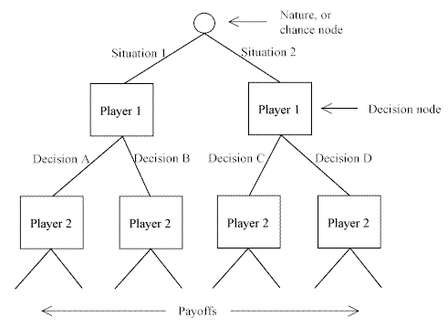
Extensive Form Game

Slide 24
Normal Form Game

Slide 25
Agenda
Initial Problem
Related Work
Approach
Outcome
Conclusion
Future Work

Slide 26
Outcome
Negotiation of Access Control Policy
  Similar to Coordination Game in Game theory

Slide 27
Critical Factors
2 person game
  have many requester to play this negotiation game at the same time.
Incomplete information.
  do not have full knowledge about the game
non-cooperative
  all requests are sent as individual
sequential game
  Negotiation again in the future.
Non-zero Sum

Slide 28
Model

Slide 29
Agenda
Initial Problem
Related Work
Approach
Outcome
Conclusion
Future Work

Slide 30
Conclusion
Introduced the problem
Overview of business collaboration and game theory
Using game theory framework to model the situation
Successful modeled

Slide 31
Future Work
Testing
  Right game? Right attributes?
Formula
Strategy
Reuse the framework

Slide 32
Thank You
Question ?

