Slide 1
ITEC 809
Securing SIP in VoIP Domain
Iyad Alsmairat
41546342
Supervisor: Dr. Rajan Shankaran.

Slide 2
Agenda
Introduction.
The Problem.
The Proposed Solution.
Conclusion.

Slide 3
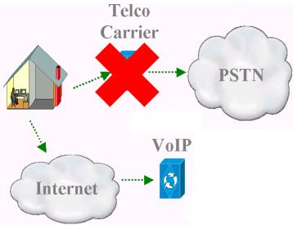
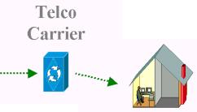


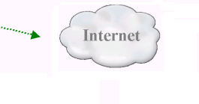
What is VoIP?
Voice over Internet Protocol

Slide 4
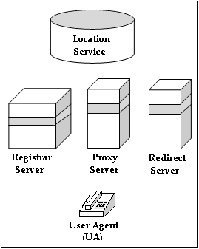
SIP Architecture
1. User Agent (UA)
2. Registrar Server
3. Proxy server
4. Redirect Server
5. Location Server

Slide 5
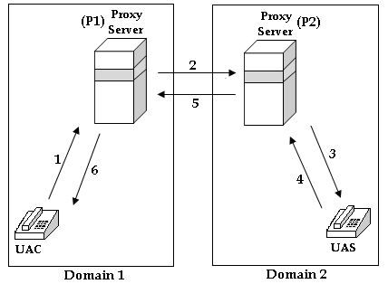
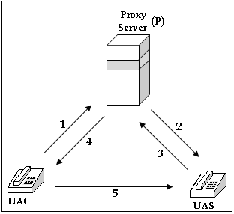
SIP Scenarios
Intra-Domain Communication
Inter-Domain Communication

Slide 6
Agenda
Introduction.
The Problem.
The Proposed Solution.
Conclusion.

Slide 7
SIP Attacks
SIP attacks include:
  Eavesdropping.
  Impersonation.
  Unauthorized Access.
  Message Spoofing.
  Session Hijacking

Slide 8
Digest Authentication
One-way authentication.
Server-to-Server is not applicable.
Does not protect integrity and confidentiality.

Slide 9
IPsec
Produces high overhead.
It is non-scalable.
Has NAT and firewall problems.

Slide 10
TLS (Transport Layer Protocol)
Only for connection-oriented communications.
Not applicable for UDP protocol.

Slide 11
Agenda
Introduction.
The Problem.
The Proposed Solution.
Conclusion.

Slide 12
Project Goals
We need to secure the SIP protocol by protecting:
  SIP Integrity.
  SIP Confidentiality.
    SIP Authenticity.

Slide 13
Security Roles
User Agent (UA):
Hide the security specifications of the session.
Declare the security capabilities.
Update the security capabilities.
Registrar Server:
Generation of user certificate.
Proxy Server:
Generation of security parameters of the session .
Verification of certificates in inter-domain communication .

Slide 14
Security Credentials
Intra-domain Communication:
Message |  | Credentials
1 | UAC → P: {user1, user2 , t_{UAC-P}, N_{UAC-P} }K_{PR(user1)} || CERT_{(user1)}
2 | P → UAS: {user1,user2, t_{P-UAS}, N_{P-UAS} }K_{PR(P)} || CERT_{(p)}
3 | UAS → P: {user1, user2, N_{P-UAS} }K_{PR(user2)} || CERT_{(user2)}
4 | P → UAC: K_{PU(user1)}[{K_{session(user1,user2)}, N_{UAC-P}} K_{PR(P)}] || K_{PU(user2)}[ {K_{session(user1, user2)}, N_{P-UAS}} K_{PR(P)} ] || CERT_{(p)}
5 | UAC→UAS: K_{PU(user2)}[{K_{session(user1, user2)}, N_{P-UAS}} K_{PR(P)} ]

Slide 15
Security Credentials
Inter-domain Communication
Message |  | Credentials
1 | UAC → P: {user1, user2 , t_{UAC-P1}, N_{UAC-P1} }K_{PR(UAC)} || CERT_{(user1)}
2 | P1 → P2: {user1, P1, user2, t_{P1-P2}, N_{P1-P2}}K_{PR(P1)} || CERT_{(P1)}
3 | P2 → UAS: {user1, t_{P2-UAS}, N_{P2-UAS} }K_{PR(P2)} || CERT_{(P2)}
4 | UAS → P2: {user1, user2, N_{P2-UAS} }K_{PR(user2)} || CERT_{(user2)}
5 | P2 → P1: {user1,user2, N_{P1-P2,}}K_{PR(P2)} || K_{PU(P1)}[{K_{session(user1, user2)}, N_{P1-P2}} K_{PR(P2)}] || K_{PU(user2)}[{K_{session(user1, user2)}, N_{P2-UAS}} K_{PR(P2)}] || CERT_{(P2)}
6 | P1 → UAC: K_{PU(user1)} [{K_{session(user1, user2)}, N_{P1-P2}} K_{PR(P1)}] || K_{PU(user2)}[{K_{session(user1, user2)}, N_{P2-UAS}} K_{PR(P2)}] || CERT_{(P1)}
7 | UAC→UAS: K_{PU(user2)}[{K_{session(user1, user2)}, N_{P2-UAS}} K_{PR(P2)}]

Slide 16
Message Mapping
Intra-domain Communication:
Security message | SIP message
1 | INVITE
2 | INVITE
3 | OK
4 | OK
5 | ACK

Slide 17
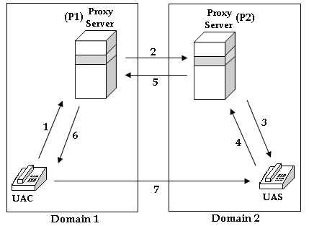
Message Mapping
Inter-domain Communication:
Security message | SIP message
1 | INVITE
2 | INVITE
3 | INVITE
4 | OK
5 | OK
6 | OK
7 | ACK

Slide 18
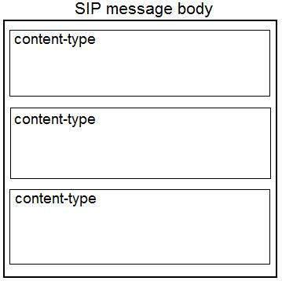
SIP Message Body
MIME (Multipurpose Internet Mail Extension).
Multi-part message.

Slide 19
Agenda
Introduction.
The Problem.
The Proposed Solution.
Conclusion.

Slide 20
Summary
SIP attacks target: Integrity, Confidentiality & Availability.
Security roles:
  User Agent.
  Registrar server.
  Proxy server.
Security protocol:
  Intra-domain communication.
  Inter-domain communication.
SIP implementation:
  Header fields.
  Message body.

