Slide 1
Hyperlinking digital libraries on the web
Juan Camilo Zapata
ITEC – 810
Supervisor
Robert Dale

Slide 2
AGENDA
INTRODUCTION
REFERENCING DOCUMENTS ON THE WEB
MANUAL PROCEDURE
FILTERING RULES
DESICION FLOW
THE TOOL
RESULTS
CONCLUSION

Slide 3




INTRODUCTION
Title: XXXXXXXX
Author: XXXXXX
Pages: XXXXX
Date: XXXXXX
Extract
References
Send the reference to be searched
Scholar article
Search for online documents using a search engine
Consolidates a list of possible URLs of web publications
HEURISTICS
REFERENCE SEARCH ENGINE
(RSE)

Slide 4
REFERENCING DOCUMENTS ON THE WEB
  Google Scholar
    Tags inserted by librarians and publishers
  Cross-Ref
    DOI Digital Object Identifier
    Created by publishers

Slide 5
MANUAL PROCEDURE
100 references from different areas
Search Engine
Result by result

Slide 6
FILTERING RULES
The number of references retrieved from a search engine to be analyzed should not be higher than 20
The title of the article must appear in the beginning of the page or PDF
The number sub pages in which the search engine have to go is no more than 1
The author is not a compulsory field but it helps to rank the link
PDF bigger than 2 pages.

Slide 7
DECISION FLOW
Receives URL
Completes URL
Is a PDF file
Clear HTML code
Heuristic rules
Process PDF
Process HTML
Return if is possible or not

Slide 8
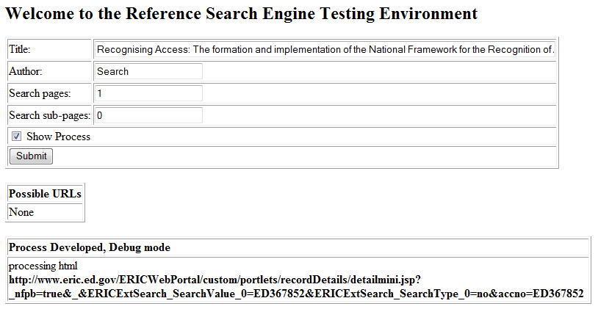
THE TOOL

Slide 9
RESULTS
1 Reference
Different scenarios
0 sublevels
Delay in response time
40 references searched
7 pages retrieved from search engine
1 level in depth

Slide 10
CONCLUSION
Manual process more precise, it is done by a human
Automatic process need more text analysis
The time of response of the application depends on the number of URLs scanned

