Slide 1
Security Framework for Wireless Sensor Networks
Presenter : Stuart Stent
Lecturer : Robert Dale
Supervisor: Rajan Shankaran

Slide 2
Agenda
The problem with Wireless Sensor Networks
The network architecture
The security issues
A solution to the problem – SE-LEACH

Slide 3

The Problem with Wireless Sensor Networks is...
...that providing adequate security is difficult due to the unique requirements and restrictions.
A Wireless Sensor Network (‘WSN’) is:
  A method of collecting data about an environment
  Comprised of multiple autonomous devices
    Sinks ( Collectors )
    Motes ( Sensors )
  An ad-hoc network where sensor data is sent from the motes back to the sink for analysis

Slide 4
Restrictions and Requirements
Requirements
  Low Cost
  Reliable and low maintenance
  Decentralised structure
Restrictions
  Low processing power
  Storage restrictions
  Finite energy supply

Slide 5
New Networking Environment
Conceptually unique
Traditional approaches not feasible
New approaches for getting data from A to B
Newly developed protocols:
  SPIN
    Sensor Protocols for Information via Negotiation
  Directed Diffusion
  LEACH
    Low-Energy Adaptive Clustering Hierarchy

Slide 6
LEACH

Slide 7

Security Issues
New and interesting playground for attackers
  Multiple methods for attack:
    Denial of Service attacks
    Routing protocol attacks
    Sybil attack
    Privacy attacks
    Physical attacks

Slide 8
Adding Security
New security techniques required to combat new attacks
    Traffic analysis prevention
    Authentication systems
    Tamper proof hardware

Slide 9
Proposed Solution
Integration of security services needed
  Awareness of resource restrictions needed during design
  Simple protocols are preferable
  SE-LEACH
  (Security Enabled - Low-Energy Adaptive Clustering Hierarchy)
  An extension to the LEACH protocol
  An extendable, modular framework for security services
  Provides a method for providing adequate security to a WSN.

Slide 10
Where to put the security ?
Physical
Physical Link
Physical Link
Data
Network
Security
Transport
Network
Network
Session
Presentation
Application
Application
Application
OSI Model
WSN Model
Proposed Model

Slide 11
Security Services
Data Confidentiality
  Encrypt what is sent
Data Integrity
  Confirm what is received is unchanged
Data Freshness
  Confirm that the message hasn’t been received before

Slide 12
Implementing the Security Services
Data Freshness
  Add a single use token
  (Message + NONCE)
Data Confidentiality
  Encrypt the message
  (Message + NONCE)Key1
Data Integrity
  Calculate a Hash or checksum of the message
  H((Message +NONCE) ⊕ Key1)
Final Transmission
  (Message + NONCE)Key1 + H((Message +NONCE) ⊕ Key1)

Slide 13
Secret Keys
Both Data Confidentiality and Data Integrity need secret keys.
There are two possible options
  Asymmetric Keys
    Each pair of nodes creates their own key
    Computationally expensive
  Symmetric keys
    Statically configured keys
    Key Distribution Centres
      How do we do this without adding infrastructure ?

Slide 14
Key Distribution Centres

Slide 15
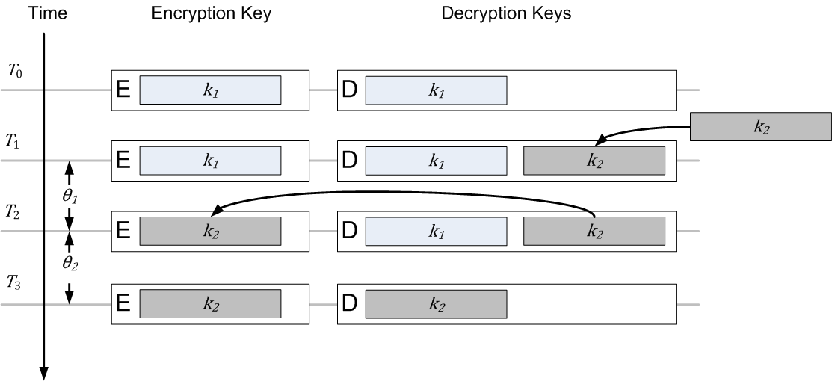
Key Distribution Schedule
Reproduced from: Bongartz, Ginzler, T., Bachran, T., & Tuset, P. (2008). SEAMAN: A Security-Enabled Anonymous MANET Protocol. NATO Research and Technology Organisation.

Slide 16
SE-LEACH
The SE-LEACH framework provides:
  Distributed key management
  Protection of all user and network routing data through:
    Data Confidentiality
    Data Integrity
    Data Freshness
  A solid foundation on which to build

Slide 17
Questions?

