Slide 1
Securing Wireless LANs and Wireless MANs
ITEC810
Securing WLANs and WMANs
By Peter Nicola
Supervisor: Dr. Michael Hitchens

Slide 2
Securing WLANs and WMANs
Agenda
What is it about?
WLAN
WMAN
Conclusion

Slide 3
Securing WLANs and WMANs
What is it about?
The world is moving from Wired to Wireless Networking.
Two forms of Wireless Networking are discussed
The need to secure them
WLAN
WMAN

Slide 4
Securing WLANs and WMANs
Agenda
What is it about?
WLANs
WMANs
Conclusion

Slide 5
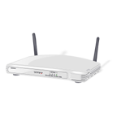
Securing WLANs and WMANs
WLAN
What is it?
Security Approaches
WEP
Algorithms
WPA
WPA2
Other approaches
MAC Filtering
SSID Broadcast

Slide 6
Securing WLANs and WMANs
WLAN
Threats
Evil Twin
War Driving
SSID:
Macquarie University
Replicated SSID:
Macquarie University

Slide 7
Securing WLANs and WMANs
WLAN
War Driving
Well Secured
Google Maps
www.wifimaps.com
Weakly or not Secured

Slide 8
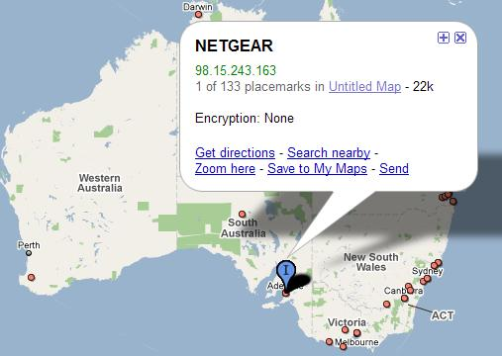


Securing WLANs and WMANs
WLAN
War Driving
Search Result in Australia
Search Result Worldwide

Slide 9
Securing WLANs and WMANs
WLAN
Outcome
Algorithm Used
Key Complexity
Keep them secured
SSID Choice - Hiding
MAC Filtering
Management Software
Possible Improvements
Digital IDs
Embedded Hardware Encryption

Slide 10
Securing WLANs and WMANs
Agenda
What is it about?
WLANs
WMANs
Conclusion

Slide 11
Securing WLANs and WMANs
WMAN
What is it?
Security Approaches
PKM (Privacy Key Management)
AK and TEK
3DES & X.509
Other approaches
DOCSIS usage
Lessons learned from WLAN

Slide 12
Securing WLANs and WMANs
WMAN
Threats and Vulnerabilities
No PHY layer protection
One Way Authentication
Jamming and DoS

Slide 13

Securing WLANs and WMANs
WMAN
One Way Authentication
So, what is the problem?
Certificate
Cryptographic capabilities, …
AK (valid for 1 → 70 days)
Key Request
TEK (valid for 12 hours → 7 days)
SS
User Traffic
BS

Slide 14
Securing WLANs and WMANs
WMAN
Outcome
Physical Layer Protection
Mutual Authentication
What can be Improved?
Shorter Key Life
How do BSs authenticate each other?

Slide 15
Securing WLANs and WMANs
Agenda
What is it about?
WLANs
WMANs
Conclusion

Slide 16
Securing WLANs and WMANs
Conclusion
Wide usage of Wireless Networks
Perfect security does not exist
Operators are encouraged to know what threats are there, and how to be secured against them
There is always a room for improvements

Slide 17
Securing WLANs and WMANs
Thanks
Thanks for your attention
Any Questions?

