Slide 1
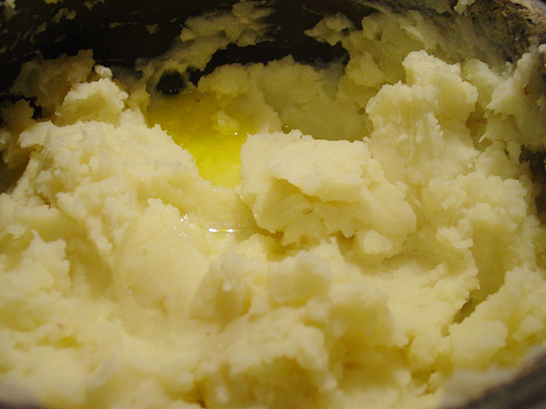
Mashups:
ITEC810 Project
By: P. M . Mathindri Nilushika Pathiraja

Slide 2

Objective
To provide a complete definition on Mashups (Web Domain).
Standard Classification Model for Mashups and Tools

Slide 3
Agenda
Introduction to Mashups
Classification of Mashups
Mashup Development Tools
Challenges

Slide 4
Agenda
Introduction to Mashups
Classification of Mashups
Mashup Development Tools
Challenges

Slide 5
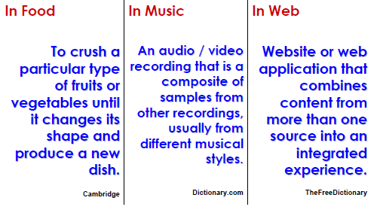
What is a Mashup?
Notes:
The term mashup has its roots in the musical domain referring to artists that mix several pieces of music, usually from different musical styles, into one single record
other domains introducing the idea of derivating a new work by mixing two or more pieces.

Slide 6
What is a Mashup?
Definition : Wikipedia
- Mashup is a Web application that combines data from two or more sources into a single integrated application.
What’s missing?
- The integration/combination of different sources is not limited to data but also to functionality and layout styles.
A Complete, Accurate definition is required.
Notes:
By extracting these terms
Web page or application, integration, combination, reuse, data sources, APIs, third party data, Web 2.0 and data processing.
I define a complete definition for Mashups.

Slide 7
Mashup Definition
Mashup is a Web-based Application that is created by combining and processing on-line third party resources, that contribute with data, presentation or functionality.
Note: Online third party resources refer to any type of resource available in the Internet.
- API
- Web feeds
- Screen Scraping
- Excel/PDF files etc

Slide 8
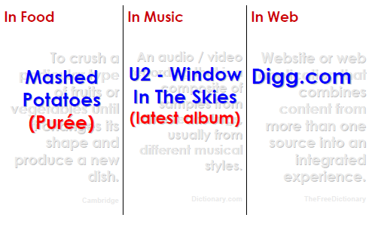
What is a Mashup?

Slide 9
Housingmaps.com
History
- Creation of Paul Rademacher.
- One of the first Mashups created.
Whats being Combined?
- List out houses, apartments, and rooms that are for sale or rent from Craigslist and displays them on a Google map.
Housingmaps = Cragilist + Google Maps
www.housingmaps.com

Slide 11
Why Mashups are Popular?
Even non technical users can create Mashups without any programming knowledge.
Explosive growth in “user-generated content”
Wide deployment of XML web services.
Increased broadband access.
Wider conceptualization of the Internet as a platform (“Web 2.0”)
Lot of user friendly tools are available.
  Microsft Popfly
  Dapper

Slide 12
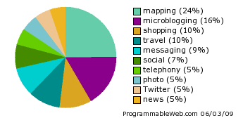
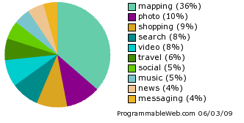
Mashup Dashboard
Last 14 days
All times

Slide 13
Agenda
Introduction to Mashups
Classification of Mashups
Mashup Development Tools
Challenges

Slide 14
Classification
Explored various Mashups available on ProgrammableWeb.
Studied existing Mashup categorization models.
They are:
  Market Overview of Enterprise Mashup Tools: By Hoyer, V., and Fischer, M
  A New Way of Providing Web Mapping and GIS Services.: By Li, S., and Gong, J
  Is IBM making enterprise mashups respectable? ZDNet Blog 2006.
  - Available: http://blogs.zdnet.com/Hinchcliffe/?p=49&tag=nl.e622

Slide 15
Classification contd..
Classified Mashups based on following four questions:
  What to Mash up?
  Where to Mash up?
  How to Mash up?
  For Whom to Mash up?.

Slide 16
1. What to Mash up?
Depending on the sort of assets being combined or integrated, Mashups are assigned to one of the following three categories:
Presentation Mashups:
  Focuses on retrieving information and layout of different Web sources without regarding the underlying data and application functionality.
  The creation of a presentation mashup requires little or no knowledge of programming languages.
  Example:
    Pre-built widgets that can be drag and drop to common user interface

Slide 17
1. What to Mash up?
2. Data Mashups:
  Merges data provided by different sources into one content page.
  The user mixes data from multiply sources and customizes the data flow of for example the Web page containing data from different sources.
  Different sources are: Web Sevices, Feeds, and HTML etc.
  3. Functionality Mashups
  Combines data and application functionality provided by different sources to a new service.
  The functionalities are accessible via APIs.
Notes:
Some one might think, that news mashups, Photo mashups, search mashups are anoher type of classification like this.
But example news Mashups etc can be refinement of presentation mashups. It can be resources mashed out of news:)

Slide 18
2. Where to Mash up?
Mashups can be distinguished depending on the location where they are mashed up.
  Server-side Mashups integrate resources on the server.
  Client-side Mashups integrate resources on the client, often a browser.
Usually a mixture of Client-side and Server-side applications is used for the creation of Mashups.
Notes:
Server-side mashups integrate resources (e.g., services and data) on the server.

Slide 19
3. How to Mash up?
Depending on the modality the resources are integrated or combined to one representation.
  Extraction Mashup: data wrapper collecting and analyzing resources from different sources and merging the resources to one content page.
  Flow Mashup: user customizes the resource flow of the Web page combining resources from different sources.

Slide 20
4. For Whom ?
Target audience the Mashups are created for and addressed to:
  Consumer Mashups: For public use
    Combines resources (e.g., layout or data) from different public or private sources in the browser and organizes it through a simple browser based user interface.
  Enterprise Mashups: For Business use
    Merges multiple resources of systems in an enterprise environment. (e.g., data and application functionality).
    Requires considering security, governance or enterprise policies.

Slide 21
Classification of Mashups
What?
Presenation Mashups
Data Mashups
Where?
Server – side Mashups
Client – side Mashups
How?
Extraction Mashups
Flow Mashups
For Whom?
Functionality Mashups
Consumer Mashups
Enterprise Mashups

Slide 22
Agenda
Introduction to Mashups
Types of Mashups
Mashup Development Tools
Challenges

Slide 23
Tools
Several tools have been published that provide functionalities for building, storing and publishing Mashups.
The range of these Mashup tools spans from open- source tools to highly-cost license tools.
Some of the vendors offer a coding editors.
While others focus on users with no programming skills that provide easy-to-use access and application to their tool suites.
Notes:
Give Examples: Tools such as MS PopFly, Yahoo Pipes, Intel Mashmaker, Derri Pipes, Dapper etc
Let us analyse how these tools can be used to creat Mashups that we classfied earlier.

Slide 24
Tools contd..
Some examples :
  Yahoo Pipes
  Intel Mashmaker
  Microsoft Popfly
  Derri Pipes
  Dapper
  Serena Mashup Composer.
  Evaluated how these tools can be used to create Mashups and were classified.
Notes:
This evaluation is done according to the mashup patterns identified earlier.
Server side and Client side classification not used. Siince it’s a matter of system configuration.

Slide 25
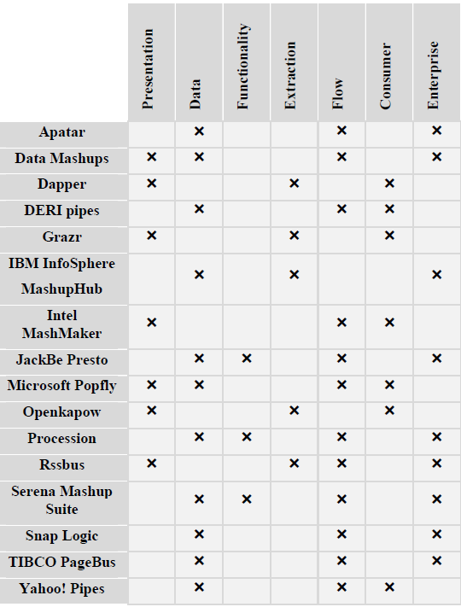

Slide 26
Challenges
Cataloguing.
  Some Web pages are already available that list Mashups and provide an interface for searching of mashups such as programmableweb.com.
  Mashup creators can insert their mashups in the list and share their Mashups with others.
  But what is missing is a directory that stores and catalogues the mashups in a consistent way.
Making Data Web enabled
  Currently a lot of data and functionalities are not set up on the Web and they are not accessible via feeds, HTML or Web services.
  To make more resources “Web-enabled” require formats and tools that facilitate an efficient access and connection of resources to the Web.
Notes:
To establish mashups as an efficient technology for resource integration the following seven challenges should be solved

Slide 27
Challenges contd..
Security and Identity
  Requires mechanisms to control the user connection and the data security.
Sharing and Re-using
  Vendors of Mashup tools should provide mechanisms to allow end-users sharing their built Mashups with others to facilitate the reuse of pre-built Mashups.
  Easy-to-use access to Mashups.
  Efficient Mashup search functionalities lightweight formats that enable even for non-programmers a smooth Mashup reuse.

Slide 28
Challenges contd..
Version Control Mechanisms
  Mashups consist of different resources collected from various sources.
  Resource owners are responsible for their content and can change and update its content whenever they regard it as necessary.
  To keep the content up-to-date a version control mechanism is required that automatically informs the Mashup owner about updates.
Trust Certificates
  No certification mechanisms exist that guarantee end-users the trustworthiness of the Mashup.

Slide 29
Conclusion
Mashups are suitable to build novel Web applications and to create new forms of visualization without little knowledge of programming languages.
Further research is especially needed in the fields of version control mechanisms, Mashup certification, Mashup quality and data integrity.

Slide 30
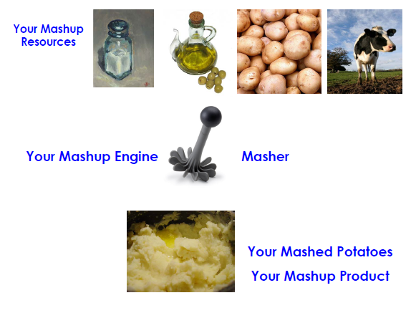

Slide 31
Mash it up!
Thank you

