Slide 1
Australia’s sci-tech accelerator
An introduction to ON
Notes:
I’d like to share some information with you about our ON accelerator experience – ON, powered by CSIRO

Slide 2
    ON is designed to fast-track
    the best Australian
    science and technology
    into real world impact

Slide 3
How?
Two free national accelerator programs designed specifically for publicly funded sci-tech researchers
ON Prime
A pre-accelerator, to test ‘product solution fit’ – getting out of the building to talk to customers and industry about how your science or technology might address a key challenge for them
ON Accelerate
Involves further market validation of the technology and establishing the right business model to make that innovation a reality – looking at scale, the right partnerships, funding, skills and resources to make it happen
Notes:
ON Prime and ON Accelerate are designed to arm researchers with the skills, capability and networks to not only validate their science in the labs, but also in the real world
ON Prime – is about problem discovery or testing ‘product solution fit’ – getting out of the building to talk to customers and industry about how the science or technology might address a key challenge for them
ON Accelerate – is about further market validation of the technology and establishing the right business model to make that innovation a reality – looking at scale and the right partnerships, funding and resources to make it happen

Slide 4
Why and which program for me?
PROGRAM | Technology Readiness Level (TRL) | Investment Readiness Level (IRL)
ON PRIME | 1-3 | 1-3
ON ACCELERATE | 4+ | 3-7
RESEARCH & DEVELOPMENT
PROVING
FEASIBILITY
INSPIRATION
IMPLEMENTATION
INNOVATION
ON PRIME
PROVING
DESIRABILITY
ON ACCELERATE
PROVING
VIABILITY
IDEATION
See appendix for further info on IRL and TRL
Notes:
We use this slide to explain the difference between the two ON offerings - ON Prime and ON Accelerate
Ideally, it helps potential applicants decide which accelerator experience is right for them
The diagram represents the three critical components of successful commercialisation of research in our (CSIRO) experience:
You need to prove the innovation is technically feasible – it needs to actually work (that’s the R&D piece);
You need to prove its desirable – people actually need to want it because it solves a problem for them or it creates value; and
You need to prove it is a viable business – i.e. you’ve defined the business model, can show it will make money etc.
We found in CSIRO and across the University sector, we’re good at the first component – the R&D
Where we required a boost in skills, relationships and capability was the second two phases – ‘testing and validating the desirability’ and ‘constructing the business model for a viable commercial offering’
That’s what ON Prime and ON Accelerate are designed to do – arm researchers with the skills, capability and networks to not only validate their science in the labs, but also in the real world
ON Prime – is about problem discovery or testing ‘product solution fit’ – getting out of the building to talk to customers and industry about how the science or technology might address a key challenge for them
ON Accelerate – is about further market validation of the technology and establishing the right business model to make that innovation a reality – looking at scale and the right partnerships, funding and resources to make it happen
The Technology and Investment Readiness Levels are another tool we use to assess how far we can take a technology or solution in the program duration
More detail on the next slide about what we’re looking for here

Slide 5

ON Prime: a pre-accelerator
What: Lean innovation for science and technology
Where: Offered in delivery hubs across Australia.
Previously offered in Sydney, Brisbane, Adelaide, Melbourne, Perth, Canberra and Newcastle. Capacity to cater for 80 teams/year
What does it involve?
Part-time experience: 5 face-to-face sessions (6 days in total) over 8 weeks
Culminates in a learnings presentation & IRL assessment
What do participants receive?
Skill development:
  Market Discovery
  Business Model
  IP Strategy
Access to strong mentor network & support functions
Invite to ON Accelerate for eligible teams
Notes:
A bit of background about the ON Prime experience and how it is delivered
It’s a part-time pre-accelerator experience
6 days in total over eight weeks
Only one residential is an overnight – the others can be fly-in, fly-out
We aim to run 2 rounds of ON Prime per year – one every six months
We run consecutive Primes across the country with each round, aim to reach at least 5 locations at once
Applications are un-capped (i.e. there is not limit on how many teams can apply), but each Prime location has eight spots available
In terms of what you gain from the experience
Teams gain exposure to market discovery, business model planning and IP Strategy experience
Access to quality mentors with specialist experience in commercialisation on deep sci-tech innovation
ON and CSIRO don’t take any of the IP or equity through this process – all IP and equity remains the property of the team and institute
If you’re interested in ON Prime
Please speak to your Program Coordinator at the University or you can contact the ON Team to register your interest at on@csiro.au
The team would also be happy to come out and speak/present to interested research teams if of value

Slide 6
ON Prime exists to empower researchers to translate their big sci-tech ideas into impact
Notes:
ON Prime does this by helping research teams find a fit between their science and technology and a customer in the market.
It gives the researchers the tools and support needed to find and talk to these customers – with the aim of testing market-related hypotheses.

Slide 7
ON Prime 3
Applications Submitted
Total
Teams
Total Participants
Delivery
Hubs
96
71
276
9
Notes:
These are the commencing numbers for ON Prime3 on program start September 2017.

Slide 8
ON Prime4 – Open for Business!
14 Nov
2017
2 Feb
2018
Late Feb
2018
From 9 Apr
2018
18-29 Jun
2018
  Applications Opened
  Applications Close
  Successful Teams Announced
  Program Commences
  Finals Presentations
Program dates*
Session 1: held between 9 April – 4 May
Session 2: held between 7 – 18 May
Session 3: held between 21 May – 1 June
Session 4: held between 4 – 16 June
Finals: held between 18 – 29 June
*Exact dates are dependent on location. The above dates are an indication of the time period when the 6 face-to-face sessions will be run
Notes:
Course dates:
ON will run concurrent programs in various locations (Could be up to 8-10 locations across Australia) within the time periods above. Exact dates will not be confirmed until locations are finalised (dependant on demand of applications).

Slide 9
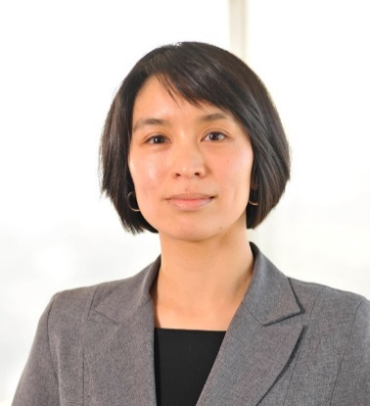
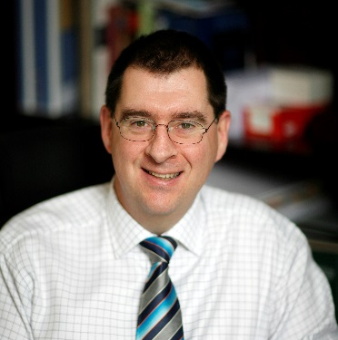

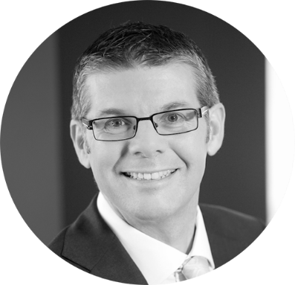
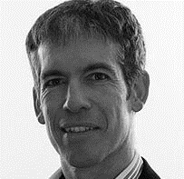
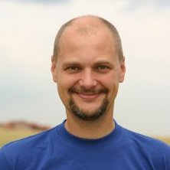
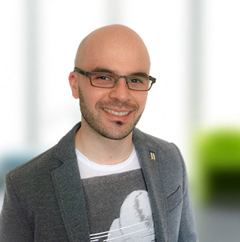
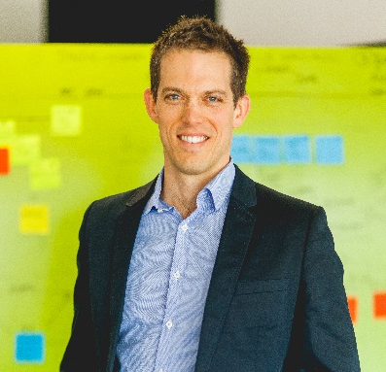
ON Prime facilitators
Lynne Teo
IP expertise and business development
Ian Brown
Experienced and
successful entrepreneur
Cameron Turner
Director, Commercial Engagement UniQuest
Brian Dorricott
Australia’s pitch expert
Jonathan Lacey
Principal, Irelya Consulting
Petr Adamek
Innovation and business expert
Nick Rakis
Business designer,
Lean Startup practitioner
David Ireland
Principal at ThinkPlace
Notes:
These are some of our facilitators for ON Prime.
We have high quality facilitators, but also facilitators who are experienced in lean innovation in a deep sci-tech environment and have great anecdotal experience in this space
You’ll find our mix of facilitators a key point of difference to other accelerators out there who typically pull from a very heavy digital background

Slide 10
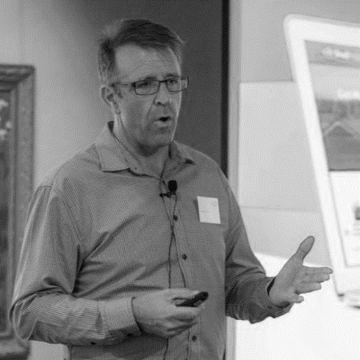
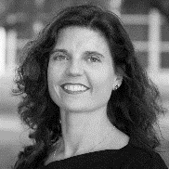



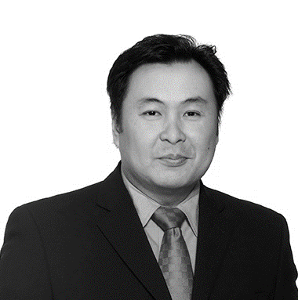

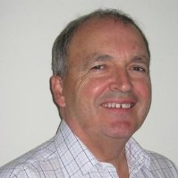
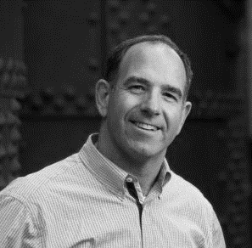

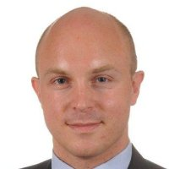
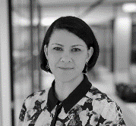
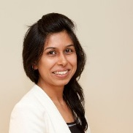
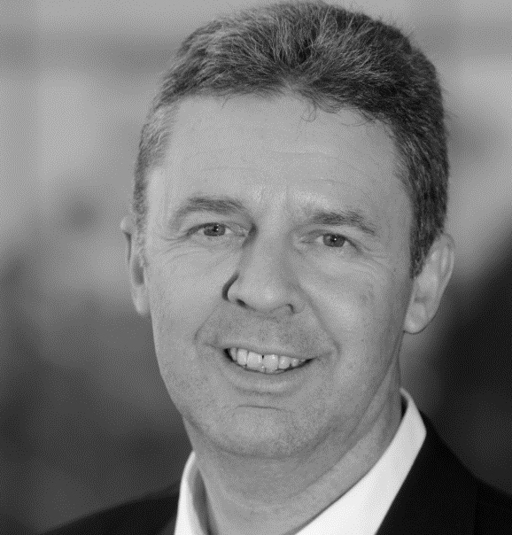
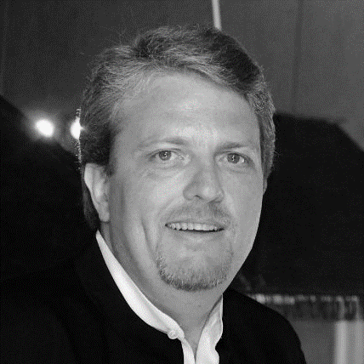

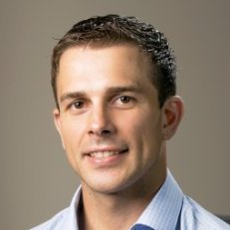
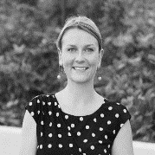
Just some of our ON Mentor Network
ANNA GROCHOLSKY
ALISTAIR MUIR
NIGEL HENNESSY
JAMES STEWART
MARTIN DUURSMA
ANTHONY MUSUMECI
PAUL CHEEVER
SHERMAN MAK
MIKE ZIMMERMAN
JAMIE LEACH
STUART WAITE
JANE SCOWCROFT
DAVID MASEFIELD
BAMBI PRICE
KHIMJI VAGHJIANI
PK RASAM
CHHAVI BHANDARI
BEN WRIGHT
Notes:
The same can be said for our mentor network which continues to grow. We’re at 85+ mentors to date.
We’re deliberately curating a different type of mentor to your ‘typical accelerator’ – mentors with deep industry connections and experience and specific experience in the commercialisation of research
They are a critical component in the success of this program
Each team that goes through ON Prime gets their own mentor and we also equip them, i.e. the teams, to be able to go out and find additional mentors to help them in their area of interest as well. For ON Accelerate, each team gets a ‘practice board’ of four mentors to work with them
In both ON Prime and ON Accelerate we’re spending more focus all the time in making the right matches and connections between mentors and teams to deliver greatest value

Slide 11
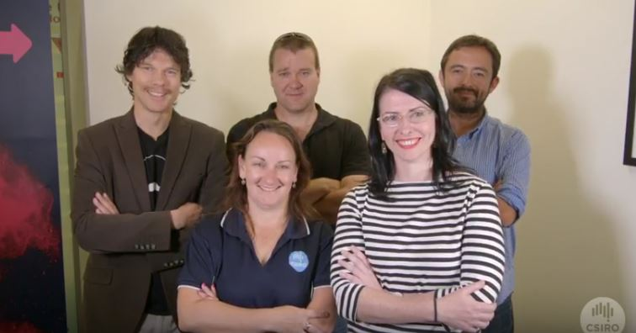
Hear from those who’ve done it before!

Slide 12
Some words from our teams
“In the past eight weeks of ON Prime, we’ve made $33K in sales. That doubles the money we’d made in four years of business”
“In the bubble of academia, it’s easy to assume – ‘oh, we’ll just commercialise and sell this product’…the reality is quite different!”
“When we applied for ON Prime, our entrepreneurial desire was high – what we quickly realised was our entrepreneurial skill-set was very low. Coming into ON Prime, we had no real business skills. That’s what the program promised and it has certainly delivered.”
“We realised in session one of ON Prime that we weren’t as developed as we had thought – in fact we were at investment readiness level 1. That was great as is showed us just how much work we needed to do and, in the eight weeks of the program, we have advanced to investment readiness level four!”

Slide 13
ON Program - Key Figures (pre Prime3)
Total
ON Program Participants
Teams
through an
ON Experience
ON Partners Signed
ON Participant Willingness to Recommend
551
132
34
94%
New Companies Formed
Post Program Commercialis-ation Grants
CSIRO Teams
in Lean Launch Pad
CSIRO Participants in Lean Launch Pad
Australian Public Sector Innovation Awards
2017 Winner
Best Culture & Practice
8
$2.3M
67
325
CSIRO Internal Program
CSIRO Internal Program
For this report we refer to “ON Program participants” defined as distinct teams/individuals that have graduated in ON Accelerate 1, 2, 3
and ON Prime 1, 2, 3. CSIRO Lean Launch Pad was delivered as an ON Program prior to NISA engagement.

Slide 14


































ON Partners
Notes:
28 University partners and 3 PFRAs have partnered with us
All the GO8 Universities, All Australian Technology Network (ATN) Universities, 4 of 6 Innovative Research Universities (IRU), 4 of 6 Regional Universities Network (RUN)
We’re open to all publicly funded Universities, and research organisations – researchers from these organisations can apply

Slide 15


How can you get involved?
Apply
Mentor
Connect
Apply to be part of ON Prime4
Applications open November 14 and close February 2 2018:
oninnovation.com.au/Apply
We’re always looking to expand our mentor network.
Know any potential mentors? Bring them ON
@ONaccelerator
linkedin.com/
company/
on-innovation-program

Slide 16
Thank you
Contact the ON team
    e ON@csiro.au
    w ONinnovation.com.au

Slide 17
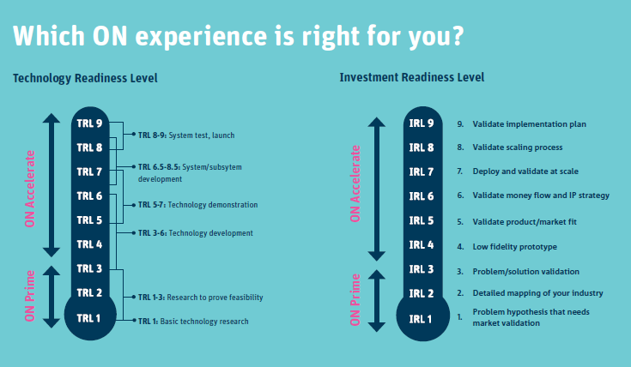
Investment Readiness Level & Technology Readiness Level charts
Notes:
Explains the different characterises of each of the IRL and TRL measures
Our guidance to teams is to apply early in either phase for ON Prime and ON Accelerate
Even if the process of progressing through ON Prime reveals that you don’t have a market or the problem you thought you were addressing is in fact not a problem at all, the feedback loop is a valuable and will help shift or shape the focus of your research
It can be an uncomfortable experience but a rewarding one – daring to fail doesn’t mean failing, it just means daring to learn!

